Slide 1
Presenter Guidance – To Customer
Title | Azure Arc overview and slide library
Main Object | Inspire customers about the possibilities that Azure Arc enables and educate them on use cases and architecture.
Audience | 100: BDM/TDM 200: TDM + Directs 300: Architects / IT Admins / DevOps Engineers / Dev Leads 400: Architects / IT Admins / DevOps Engineers / Dev Leads MSP: Practice owners / Architects
Content Level | 100-400
Deck Owner | Sanjay Satheesh
Usage Guidance | This is a slide library vs. an E2E deck. This deck can be shared with customers and partners except for the slides marked ‘Internal Only’. These slides can be used to assemble a deck for the following sales scenarios: Scenario A (L100): Customer is interested in learning more about Azure Arc Audience: BDM, TDM ; Role: ATS Land the problem statement (customer challenges) and how Azure Arc simplifies their IT environment with the high-level use cases Include customer examples Close with the resources available to customers (Get Started slide) Scenario B (L200): Customer wants to understand how Azure Arc works and its capabilities Audience: TDM + Directs ; Role: Infra/App Dev Specialists w/support from Data Specialists if needed Land the problem statement (customer challenges) and how Azure Arc simplifies their IT environment with the high-level use cases Unpack Azure Arc (Section – ‘Arc extends the Azure control plane…’) and explain the different capabilities (servers, K8s and data services) Tie the capabilities back to use cases with customer examples Share pricing and roadmap information (Use the Pricing examples in the Appendix if needed) Close with the resources available to customers (Get Started slide) Scenario C (L300/400): Customer wants a deep dive on Azure Arc Audience: Architects / IT Admins / DevOps Engineers / Dev Leads ; Role: CSA Land the problem statement (customer challenges) and how Azure Arc simplifies their IT environment. Unpack Azure Arc (Section – ‘Arc extends the Azure control plane…’) and explain the different capabilities (servers, K8s and data services) Tie the capabilities back to use cases with customer examples Use the L300 and L400 sections to discuss the architecture in depth. Demos: leverage the Jumpstart GitHub repo to prepare demos.
Version | 1.2

Slide 2
Presenter Guidance – To Partner
Title | Azure Arc overview and slide library
Main Object | Inspire partners on how Azure Arc can help them manage their customers’ disparate environments, at scale with ease. Additionally, use this deck to educate partners on how they can capture new opportunities and drive consumption with Azure Arc.
Audience | 100: Practice leads 200/300: Architects
Content Level | 100-400
Deck Owner | Sanjay Satheesh
Usage Guidance | This is a slide library vs. an E2E deck. This deck can be shared with customers and partners except for the slides marked ‘Internal Only’. These slides can be used to assemble a deck for the following sales scenarios: Scenario: Recruit MSPs to add Azure Arc capabilities to their practices L100: Audience: Practice Leads ; Role: PDM Land the problem statement (customer challenges) and how Azure Arc can help the partner manage the IT environment with ease. Include the high-level use cases and customer examples. Use the Partner business value section to outline opportunities for partners, including integration with Azure Lighthouse Share pricing and roadmap information (Use the Pricing examples in the Appendix if needed) Close with the resources available (Get Started slide) L300 / L400: Audience: Architects ; Role: OCP CSA Land the problem statement (customer challenges) and how Azure Arc can help the partner manage the IT environment with ease. Unpack Azure Arc (Section – ‘Arc extends the Azure control plane…’) and explain the different capabilities (servers, K8s and data services) Tie the capabilities back to use cases with customer examples Use the L300 and L400 sections to discuss the architecture in depth. Demos: leverage the Jumpstart GitHub repo to prepare demos.
Version | 1.2

Slide 3

Azure Arc overview
Notes:
Hello, my name is NAME and I work in TITLE.
Today I would like to talk to you about Azure Arc, a set of technologies that give you a single pane of glass view across your cloud and on-premises infrastructure.

Slide 4



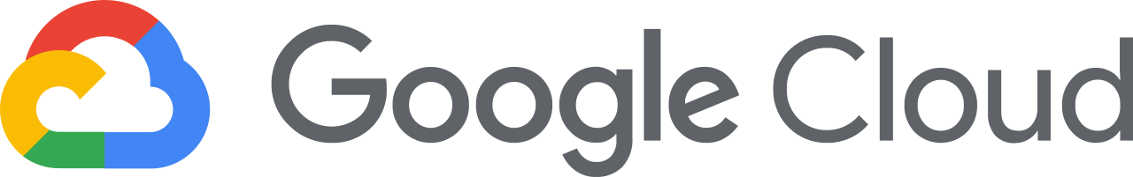










Customer environments and application requirements are evolving
Single control plane with Azure Arc
How to govern and operate across disparate environments?
How to ensure security across the entire organization?
How to best enable innovation and developer agility?
How to meet regulatory requirements and overcome technical hurdles?
100’s–1,000’s of apps
Diverse infrastructure
Multi-Cloud
VMs
Databases
Datacenters
Hosters
Containers
Serverless
Branch offices
OEM hardware
IoT devices
Edge
Notes:
Today, customers often have tens and hundreds and even thousands of applications in their IT environments. These applications run in a diverse infrastructure with data centers, hosting environments and branch offices and they may also run in multi-cloud scenarios where we see 2 or more clouds being used. To add to this complexity, customers also use different development tools, languages and frameworks as well as technologies like DevOps, Kubernetes and AI.
If you have a situation like this, the key questions that I expect you to ask are :
How to view, govern and secure IT resources seamlessly regardless of where they are running?
How to bring cloud innovation to existing infrastructure?
How to modernize local datacenters with new cloud infrastructure?
How to extend compute and AI to the edge to unlock new business scenarios?
At Microsoft, we have long understood this reality our customers are facing. Microsoft Azure has been designed from the beginning to help customers meet these challenges.

Slide 5

Azure Hybrid
Innovation anywhere with Azure
Azure
Single control plane with Azure Arc
Bring Azure services to any infrastructure
Modernize datacenters with Azure Stack
Extend to the edge with Azure IoT
Notes:
So as you saw just now on the previous slide, taking a hybrid approach makes the most sense for customers today. Azure takes a comprehensive approach and offers unique hybrid capabilities that give customers the flexibility to innovate anywhere in their environment and Azure Arc adds to our portfolio of hybrid solutions.
With Azure Arc, you can have a single pane of glass view across your entire infrastructure. These include Linux/Windows VMs, Kubernetes clusters and Database services across multicloud, on-premises and the edge. And, with Azure Arc enabled services, you have the flexibility to deploy Azure fully managed services anywhere – on-premises or in other public clouds.
With the Azure Stack portfolio, you can bring Azure consistent infrastructure to your own datacenters, even running it on existing certified hardware with Azure Stack HCI.
Lastly, we know that increasingly new apps often include running some aspects at the edge. So we’ve brought in our comprehensive Azure IoT portfolio so there is consistency in the developer, management, and security experiences all the way to the gateway or on tiny MCU devices like Azure Sphere.
So now that we have seen how Azure Arc fits into our overall hybrid strategy in Azure, let’s look at what Azure Arc does.

Slide 6



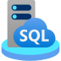

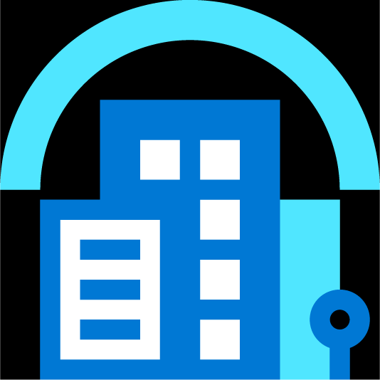
Manage & Operate your infrastructure from the Azure control plane and run Azure services on your infrastructure
Azure Arc
Multi-cloud
Datacenter
Edge
Notes:
With Azure Arc, we are all about meeting you where you are with a keen understanding of your IT environment.
This means that you can now manage and operate all of your existing IT resources consistently and at-scale, wherever they reside, from Azure. You can also run Azure services anywhere – on-premises or in other public clouds so you can take advantage of cloud benefits everywhere, such as scalability, fast deployment, and always up-to-date cloud innovation.

Slide 7
Azure Arc
Azure Arc enabled infrastructure
Connect and operate hybrid resources
as native Azure resources
Azure Arc enabled services
Deploy and run Azure services outside of Azure while still operating it from Azure
Multi-cloud
Datacenter
Edge
Notes:
To unpack this a bit more, Azure Arc enabled infrastructure enables you to connect your resources, which live outside of Azure today, and operate them as if they where native Azure resources, using the same management tools and services that Azure provides.
And with Azure Arc enabled services, you have the flexibility to deploy fully managed Azure services anywhere – on-premises or in other public clouds so you can take advantage of cloud benefits everywhere, such as scalability, fast deployment, and always up-to-date cloud innovation. What’s awesome is that you can initiate and manage these deployments, right from the Azure Portal.

Slide 8

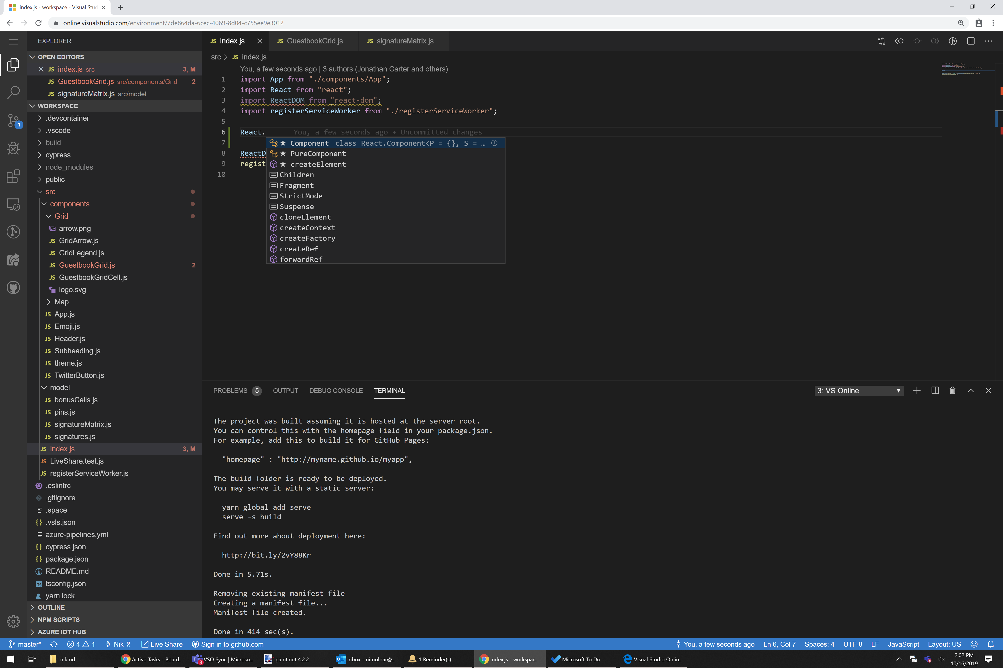

Azure Arc use cases
Organize and govern across environments
At-scale Kubernetes app management
Run data services anywhere
Azure is already trusted and proven by our customers. Azure Arc uses the same APIs and the same control plane as Azure, providing consistency across the hybrid infrastructure, which increases productivity and reduces risk.”
With Azure Arc, we can centrally manage multiple edge locations and help our customers grow and expand across the continent, creating more jobs and economic opportunities along the way."
For me, the main benefit is that my managers do not have to go to three different places to see the health of our database environment. I want to reinforce this over and over again because that’s what’s driving us.”
Notes:
So what this means is that you can benefit from 3 core scenarios with Azure Arc today.
First, you can organize all your resources consistently in Azure, whether they are on Windows, Linux, SQL Server or containers. You can govern and control them in a homogenous way and you can get visibility to them from a single pane of glass, all from within Azure.
Next, you can leverage the cloud native app development practices, meaning you can use DevOps techniques to deploy and manage Kubernetes apps at scale and make sure they are configured consistently as you build your Kubernetes based applications.
And lastly, you can run those Azure managed services, Azure SQL Managed Instance and Azure PostgreSQL Hyperscale anywhere.
Let’s look at a few real examples for each of these scenarios

Slide 9



Azure is already trusted and proven by our customers. Azure Arc uses the same APIs and the same control plane as Azure, providing consistency across the hybrid infrastructure, which increases productivity and reduces risk.”
With Azure Arc, we can centrally manage multiple edge locations and help our customers grow and expand across the continent, creating more jobs and economic opportunities along the way."
For me, the main benefit is that my managers do not have to go to three different places to see the health of our database environment. I want to reinforce this over and over again because that’s what’s driving us.”
Mike DeLuca
Global Lead for Hybrid
Calvin Karundu
Software Engineer
Kristina Melo
SQL Database Administrator
Notes:
For the first use case of uniform management and governance, we have Avanade, of the largest global systems integrators, who are using Azure Arc to unify its customers’ hybrid infrastructure. By embracing Azure Arc, Avanade is helping its customers simplify and standardize infrastructure management, accelerate migration decisions, reduce costs, and ensure regulatory compliance.
<Read more here to summarize the story - https://customers.microsoft.com/en-us/story/836305-avanade-partner-professional-services-azure-arc>
For the next use case pertaining to Kubernetes app management at-scale, we have an amazing story. With locations spread across Africa, Kenya-based company Africa’s Talking provides custom mobile, voice, messaging, and payment APIs for large organizations and thousands of developers. But with limited cloud services in some regions, the company found it difficult to offer the containerization capabilities its customers needed to meet their business requirements and goals. By using Microsoft Azure Arc, Africa’s Talking can manage multiple Kubernetes clusters and deploy data services wherever they’re needed from a centralized point of control, helping its customers grow and create more opportunities across the continent.
<Read more here to summarize the story - https://customers.microsoft.com/en-us/story/842233-africas-talking-partner-professional-services-azure-arc>
And finally, we have Ferguson, the largest wholesale distributor of plumbing supplies in the United States, who are using Azure Arc to deploy Azure data services to its on-premises datacenters. The company migrated a SQL Server database to an Azure Arc enabled SQL Managed Instance, enabling it to use features such as automated updates, backup/restore, and monitoring, all in their own datacenters.
<Read more here to summarize the story - https://customers.microsoft.com/en-us/story/844232-ferguson-enterprises-retailers-azure-arc>
With the above examples, we can really see the difference Azure Arc delivers for customers across different industries.

Slide 10





























1
2
4
5
Azure Arc
6
7
8
9
10
11
12
13
14
15
Notes:
And in fact, we have many more of these stories of Azure Arc customers across healthcare, professional services, manufacturing and more.
You can check these out at customers.microsoft.com and search for “Azure Arc”.

Slide 11
Customer challenges when hybrid
Complexity
“I need to have health visibility in a single pane of glass to all my existing and future infrastructure and applications.”
Regulation
“Our DB layer must remain on-premises due to sensitive patient data and data availability needs.”
Compliance
“I need to manage security and incident management across my public cloud and datacenter assets.”
Latency
“We can’t take a dependency on the internet. If we lose connectivity, we still want to be able to access the data.”
Inconsistency
“I want my on-prem skills to work in the cloud, and my cloud skills to work on-prem.”
Legacy
“Our older systems take too much maintenance. We want evergreen technology and to pay for it like a utility.”
Multi-cloud
Datacenter
Edge
Notes:
Now that we’ve established hybrid is the norm for most customers today, let’s try to understand the challenges that customers are facing today with this model.
From an infrastructure point of view, we understand that some of this must remain on-premises. But it is complex, and we often hear customers say they need to have visibility into the health of all their existing as well as future infrastructure and applications in a single pane of glass. Second, from an IT point of view, while organizations understand the need for implementing a governance standard, they find it hard to integrate on-premises policies and updates with their cloud infrastructure. Third, since there are often different app development teams in the organization, there exists a wide range of skills across on-premises and cloud. Customers are looking for consistent inter-operability between the two so they can unify development practices.
Now, let’s also consider the deployment of cloud native services. Some customers operate in highly regulated industries (e.g. govt infrastructure, healthcare, FSI) where both internal and customer data are deemed critical and must remain within the boundaries of on-premises datacenters. There could also be a need for latency requirements where the data processing needs to happen close to the source of data while minimizing disruptions that may arise from internet connectivity issues. Another common scenario is that customers don’t want the management overhead of maintaining these services on-premises and would like to flip to a cloud billing model.

Slide 12
Azure Arc
Azure Arc enabled infrastructure
Azure Arc enabled services
Connect and operate hybrid resources as native Azure resources
Deploy and run Azure services outside of Azure while still operating it from Azure
Visibility
Bring distributed Windows, Linux, SQL and Kubernetes together a single plane of glass
Flexibility
Reduce risk and adhere to regulatory requirements by deploying cloud services on-premises
Compliance
Reduce risk and cost by establishing a single governance frame for all your workloads without additional overhead or additional approval processes
Latency
Deploy data services on-premises, close to your data sources with support for both disconnected and connected workloads
Consistency
Simplify the way you work by consolidating tooling and using cloud-native technology and practices everywhere
Always current
Get evergreen SQL and PostgreSQL Hyperscale on-premises with a cloud billing model
Multi-cloud
Datacenter
Edge
Notes:
With Azure Arc, we are helping you address these challenges.
(1) Azure Arc enabled infrastructure enables you to have a single pane of glass view of all your resources – Windows, Linux and SQL Servers as well as Kubernetes containers so you have a better inventory of your IT assets. You can also reduce risk within your organization by establishing a governance framework and applying a standard set of policies for all your workloads. Server/app owners can now view compliance status of their own servers and take necessary remediation steps from the Azure Portal, This removes some of the management overhead on central IT in tracking and ensuring adherence to compliance standards. Lastly, Azure Arc also helps you adopt cloud practices on-premises – you can deploy applications using a consistent approach (familiar tools/practices) across all your Kubernetes clusters, on any infrastructure. You can standardize change control with declarative configuration management systems like GitOps and you can also easily adopt DevOps techniques, such as Infrastructure as code and empower developers with self service and a selection of tools.
(2) With Azure Arc enabled services, you have the flexibility to deploy fully managed Azure services anywhere – on-premises or in other public clouds so you can take advantage of cloud benefits everywhere, such as scalability, fast deployment, and always up-to-date cloud innovation, while adhering to regulatory requirements.
These data services can be deployed and managed from within your on-premises environment or in your own customers’ regions, thus reducing the latency. Finally, you can access the latest Azure features and capabilities for on-premises data workloads. Today, in public preview you can deploy evergreen SQL (SQL Managed Instance) and PostgreSQL Hyperscale on any infrastructure and benefit from automatic updates, patches and upgrades without application downtime.
So how does Azure Arc actually work and achieve these things? To understand this better, let’s take a moment to ground ourselves on how Azure works <Click>

Slide 13

Azure customers
Develop & operate
Secure | Monitor | Protect | Automate | Develop
Tools and experiences
Inventory, Organization, Governance
Control
Extensibility for new resources
Servers | Kubernetes Clusters | Databases | etc.
Resources
Over 200 services
Azure Regions
Facilities
Notes:
A very important concept here is the Azure Control plane.
Customers connect to Azure using different tools or experiences such as the Azure Portal. What’s happening behind the scenes is that those tools and experiences are interacting with the Azure Control plane which is essentially Azure Resource Manager or ARM. Every single resource in Azure is connected to this control plane. Azure Resource Manager at its core, provides a core set of capabilities – inventory, organization and governance for Azure resources, which you can see on the slide (Servers/K8s/data services). As an example, when you want to a create a new resource in Azure, that request is received by the Azure Resource Manager, which then authenticates and authorizes the request. Resource Manager sends the request to the specific Azure service, which takes the requested action. So you essentially have a consistent tool for working with all your Azure resources. Once these resources are created, you can attach additional Azure Management services such as Azure Monitor, Azure Security Center to these resources. <Click>

Slide 14
Azure customers
Develop & operate
Secure | Monitor | Protect | Automate | Develop
Tools and experiences
Inventory, Organization, Governance
Extensibility for new resources
Control
Azure Arc
Servers | Kubernetes Clusters | Databases | etc.
Azure Arc enabled infrastructure
Azure Arc enabled services
Resources
Azure Regions
Facilities
Multi-cloud
Datacenter
Edge
Notes:
So what we did with Azure Arc is to extend this single control plane within Azure and those same capabilities , that we just talked about, to resources outside of Azure. This involves deploying an agent on the servers or Kubernetes clusters so these resources can be projected to the Azure Resource Manager. Once the initial connectivity is done, you can now see all these resources in the Azure Portal. You can group these resources, apply tags and RBAC policies as well as attach Azure management services such Azure Monitor, Azure Security Center etc., the same way as you would for Azure resources. So for IT admins, Azure Arc really brings that consistency and single pane of glass experiences to thousands of servers in customer environments.
A key point to add here is that you can continue to use your existing tools on-premises to interact with these resources, we are not interfering with any of those management tools.

Slide 15


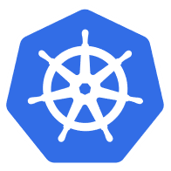

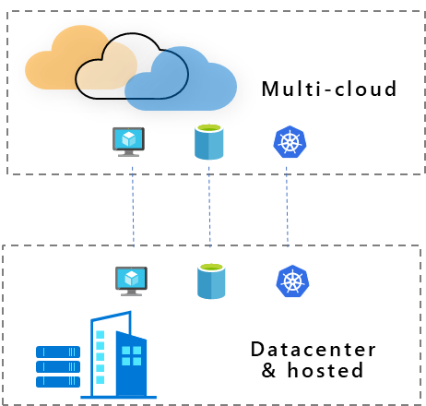
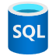
Azure Arc Bring Azure services and management to any infrastructure
Multi-cloud
Datacenter & hosted
Organize and govern across environments
At-scale Kubernetes app management
Run data services anywhere
Get servers and Kubernetes clusters that are sprawling across clouds, datacenters and edge under control by centrally organizing and governing from a single place.
Deploy and manage Kubernetes applications at scale across environments using DevOps techniques, ensuring that applications are deployed and configured consistently from source control, at scale.
Deploy and manage data services where you need it for latency or compliance requirements. Stay always current with evergreen SQL and seamlessly manage and secure your data assets across on-premises, clouds, and edge.
Notes:
Now that we understand how Azure Arc works, let’s look at this with a few simple use cases that Azure Arc helps you with and when to use it.
First, if you have workloads running outside Azure, you can now organize all your resources consistently in Azure, whether they are on Windows, Linux, SQL Server or containers. You can govern and control them in a homogenous way, and you can get visibility to them from a single pane of glass, all from within Azure.
Next, you can leverage cloud native app development practices, meaning you can use DevOps techniques to deploy and manage Kubernetes apps at scale and make sure they are configured consistently as you build your Kubernetes based applications. You can also standardize change control with declarative configuration management systems like GitOps, a popular Kubernetes operating model.
And lastly, you can run those managed Azure data services like Azure SQL Managed Instance and Azure PostgreSQL Hyperscale anywhere.
Let’s look at a few real examples for each of these use cases.

Slide 16


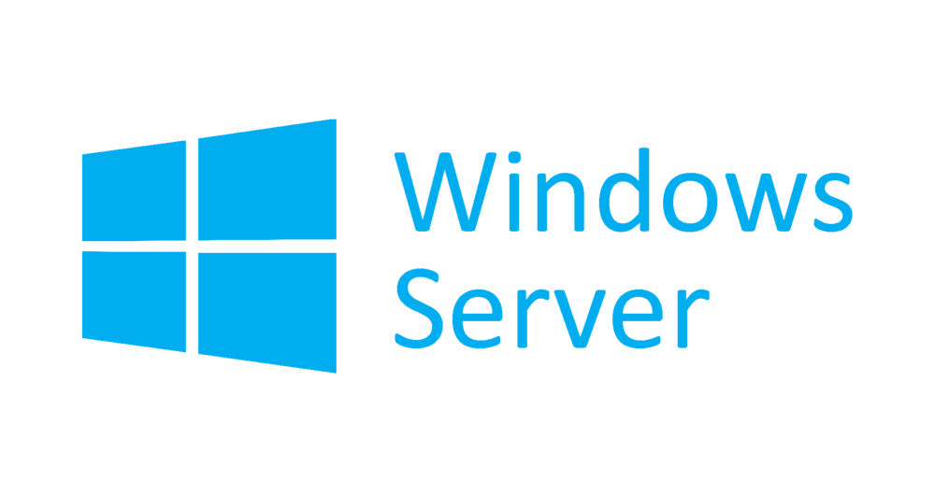





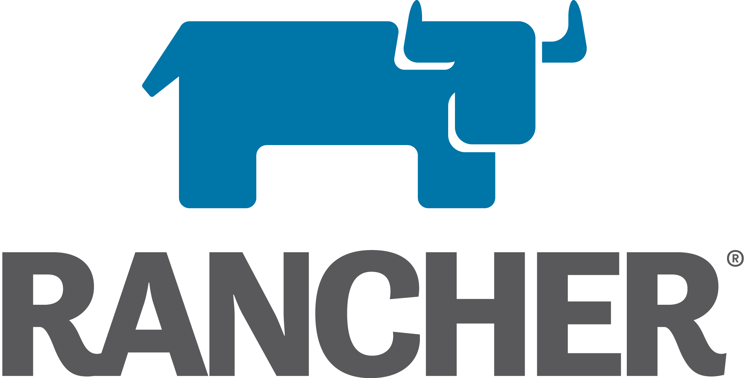


Azure Arc enabled infrastructure Bring on-premises and multi-cloud infrastructure to Azure with Azure Arc
Azure Arc enabled servers
Azure Arc enabled SQL Server
Azure Arc enabled Kubernetes
Organize, inventory, and monitor
Governance and Security
Simplified role-based operations
Physical, Virtual, Windows, Linux
Organize, inventory, and monitor
Governance and Security
Use with your existing SQL servers
SQL on Windows or Linux servers
Organize, inventory, and monitor
Governance and Security
Monitoring and Policy
GitOps-based zero-touch deploy
AKS on Azure Stack HCI
OpenShift
AWS Linux 2
Now available
Now in public preview
Public preview
Notes:
So we talked about Azure Arc extending the Azure control plane to your existing infrastructure and we saw a real example where this scenario comes to life.
Let’s talk about what kind of Infrastructure services you can enable with Azure Arc – with GA of Azure Arc enabled servers, we support Windows Server and a wide range of Linux operating systems such as SUSE and RedHat. On Arc enabled SQL Server, which is in public preview, in addition to the governance and inventory benefits, you are able to take advantage of additional value such as Azure Security services or proactive SQL assessments ensuring your databases are optimally tuned.
On Arc enabled Kubernetes, we support a wide range of distributions, again offering you that flexibility of choice without forcing you to stick to a single solution. You can use cloud native tools practices and GitOps configuration and app deployment to one or more clusters at scale. We also announced the preview of AKS on Azure Stack HCI at Ignite which lets customers deploy and manage containerized applications on Azure Stack HCI, which can be managed by Azure Arc.

Slide 17



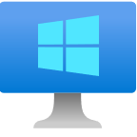


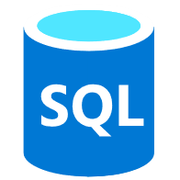
Customer scenario Organize & govern across environments
Multi-Cloud
Overview
A large financial institution has sprawling server-based IT systems deployed in corporate datacenters, hosters, and multi-cloud.
The sprawl is overwhelming, and it is impossible to manage and apply consistent governance across the environment and meet compliance needs
Business requirements
Manage a mix of bare metal, Windows and Linux servers across locations and disparate systems
Enable IT to apply at scale governance and security policies across all servers
Enable application owners to apply, audit and remediate compliance to meet their own requirements
On-Premises / Hosted Datacenters
Notes:
Let’s look at the first scenario we talked about just now – Organize and govern across environments.
Consider this… We are working with a large financial organization with thousands of servers deployed in multiple locations. They are also using DevOps practices which result in an unknown number of servers that are connected to the corporate networks but do not conform to identity and governance requirements.
This customer really needs to gain some control of their environment and ensure the compliance requirements are met for audit purposes.

Slide 18
Customer scenario Organize & govern across environments
Multi-Cloud
Key benefits from Azure Arc
Asset organization and inventory with a unified view in the Azure Portal
Universal governance anywhere through Azure Policy
Centralized agent management – Monitoring, Security, Update Management and more
Built-in server compliance rules
Central compliance view across all servers
Self-service remediation
Integration with Azure Lighthouse
Azure Arc
Azure Management
(Azure Resource Manager, Azure Policy, Azure Portal, API, CLI…)
Azure Arc
On-Premises / Hosted Datacenters
Notes:
Let’s look at the first scenario we talked about just now – Organize and govern across environments.
Consider this… We are working with a large financial organization with thousands of servers deployed in multiple locations. They are also using DevOps practices which result in an unknown number of servers that are connected to the corporate networks but do not conform to identity and governance requirements.
This customer really needs to gain some control of their environment and ensure the compliance requirements are met for audit purposes.

Slide 19
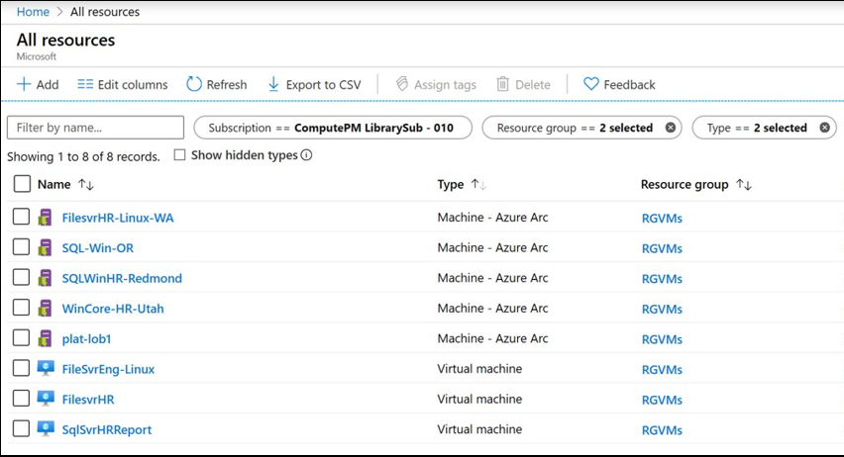
Notes:
Let’s take a peek into the Azure Portal to see what this looks like. You can see that the 3 Azure VMs at the bottom appear alongside the 5 Azure Arc VMs.

Slide 20
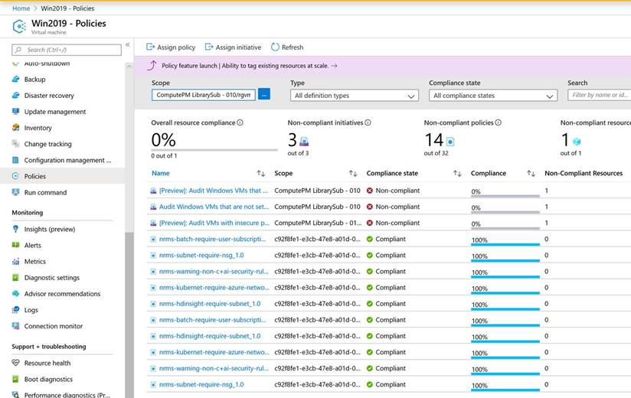
Notes:
If you look here at an individual Azure Arc machine, you can see that a lot of the policies that were set previously by Central IT, are automatically inherited just by onboarding the machine to Azure with Azure Arc. Now as a server owner, I can see that my machine is not fully compliant, so I can go and investigate and fix this myself. This ensures a strong collaboration between IT and DevOps teams, which was one of the business requirements set forth by the customer.

Slide 21
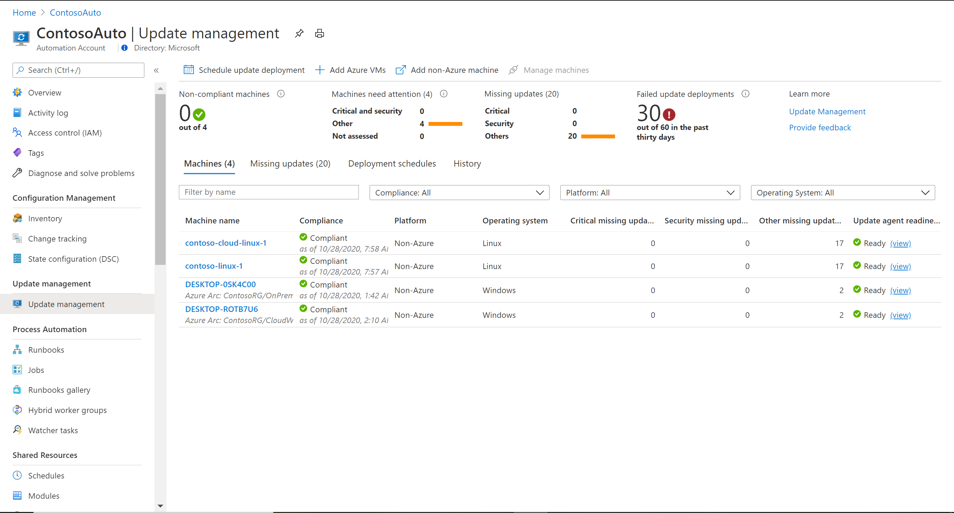

Slide 22



Azure Arc enabled servers Bring on-premises and multi-cloud servers to Azure with Azure Arc
Reach
Organize and Inventory
Governance and Security
Role-Based Operations
Linux and Windows
VM and Bare-Metal
Domain agnostic
At scale searchable inventory
Unify management experience
Consistent VM extensions
Integrate with Azure Lighthouse
Built-in Azure policies
Server security baselines
Compliance across environments
Centralized agent management – Monitoring, Security, Update Management
Central IT to manage at-scale operations
Workload owners manage based on their access
Any infrastructure, familiar tools
Notes:
So, just want to summarize Azure Arc enabled servers for you.
You can onboard a wide variety of servers to Azure with Azure Arc – Windows, Linux, VM, Bare-Metal that are running anywhere. You can organize all these servers and apply governance across all these servers and apply role-based access control. In addition, you can also deploy Azure VM extensions to non-azure Windows and Linux VMs, simplifying the management of your hybrid machines on-premises, edge and other cloud environments. All of these capabilities are unparalleled in the market today.

Slide 23
Azure Arc enabled servers Azure Arc enabled servers are auto-enrolled with additional Azure services
Additional services
Azure Policy
Azure Defender
Azure Sentinel
Azure Monitor
Change and inventory tracking
Update management
Azure Security Center
AWS Linux 2
Just turn them on when you want to use them
Notes:
Remember, I talked earlier about how Azure Arc extends Azure management services to your non-Azure VMs? Well, a common question we get is : Which management services can I use with my Arc enabled VMs. As you can see here, we have a variety of Azure management services, all of which can be applied to your Arc enabled machines today.

Slide 24
Azure Arc enabled servers The future of Microsoft Endpoint Configuration Manager (formerly SCCM)
The Azure management services enabled by Azure Arc can replace much of the functionality of MECM, but we recommend a gradual transition based on the use case. In some cases, MECM cannot be replaced yet.
On-Premises VMs
MECM
Azure Arc
Capabilities
Change and inventory tracking
Update/patch management
Security
Notes:
Remember, I talked earlier about how Azure Arc extends Azure management services to your non-Azure VMs? Well, a common question we get is : Which management services can I use with my Arc enabled VMs. As you can see here, we have a variety of Azure management services, all of which can be applied to your Arc enabled machines today.

Slide 25
Azure Arc enabled servers Co-management with Microsoft Endpoint Configuration Manager (MECM – formerly SCCM)
Use case | MECM | Azure management service enabled by Azure Arc
Software updates on Windows Server machines anywhere
Software updates on Linux machines anywhere
Software updates on your Windows clients (running say Windows 10)
Software updates for on-premises systems which are behind an internet gateway
Server inventory and information collection
Run custom scripts on machines
MECM tracks and applies software updates to Windows Server machines in your organization
Azure Update Management uses the Log Analytics agent and can run on supported Windows Server OS for patch/update control
Azure Update Management uses the Log Analytics agent and can run on supported Linux distributions for patch/update control
N/A
MECM manages the deployment of software updates to clients in your organization
N/A
MECM can work with and configure cloud gateways. Boundary groups. Proxy etc. to manage the machines
Azure Update Management can work with the Log Analytics Gateway, to manage machines behind proxy and firewalls
MECM CMPivot can provide real time state of machines in the environment
Azure Automation Change Tracking and Inventory tracks changes in virtual machines and server infrastructure
Use Custom Script Extension in Azure or Process Automation in Azure Automaton to create and manage PowerShell scripts and workflows, Python scripts and graphical runbooks.
MECM has an integrated ability to run custom PowerShell scripts
Notes:
Remember, I talked earlier about how Azure Arc extends Azure management services to your non-Azure VMs? Well, a common question we get is : Which management services can I use with my Arc enabled VMs. As you can see here, we have a variety of Azure management services, all of which can be applied to your Arc enabled machines today.

Slide 26
Azure Arc enabled servers Co-management with Microsoft Endpoint Configuration Manager (MECM – formerly SCCM)
Use case | MECM | Azure management service enabled by Azure Arc
Create, manage and deploy applications on machines
Manage OS upgrades
Manage policies to mitigate malicious attacks and security vulnerabilities
MECM can manage deployment of applications and packages with automation built-in
Use Azure Custom Script Extension to deploy apps and packages to VMs, doesn’t have a UI like Software Center in MECM
MECM can deploy and update Windows via different methods and automate tasks
N/A
MECM manages policies for Windows Defender, Bit locker, VPN etc. to secure machines
Azure Security Center provides unified security management and advanced threat protection across hybrid cloud workloads.
Notes:
Remember, I talked earlier about how Azure Arc extends Azure management services to your non-Azure VMs? Well, a common question we get is : Which management services can I use with my Arc enabled VMs. As you can see here, we have a variety of Azure management services, all of which can be applied to your Arc enabled machines today.

Slide 27



Azure Arc enabled SQL Server Data management benefits for Azure Arc enabled servers
Flexibility
Management
Governance and Security
VMs and bare-metal servers
On-premises and multi-cloud
Searchable inventory
SQL Assessment service
Azure Policy
Azure Defender
No migration needed for existing SQL Servers
Notes:
Use the Azure Portal to register and track the inventory of your SQL Server instances across on-premises, edge sites, and multi-cloud in a single view.
Use Azure Security Center to produce a comprehensive report of vulnerabilities in SQL Servers and get advanced, real time security alerts for threats to SQL Servers and the OS.
Investigate threats in SQL Servers using Azure Sentinel.
Periodically assess SQL Server environment to receive actionable health guidance.
You can also govern across all your SQL Servers with built-in Azure policies to audit and secure your SQL Server estate.

Slide 28
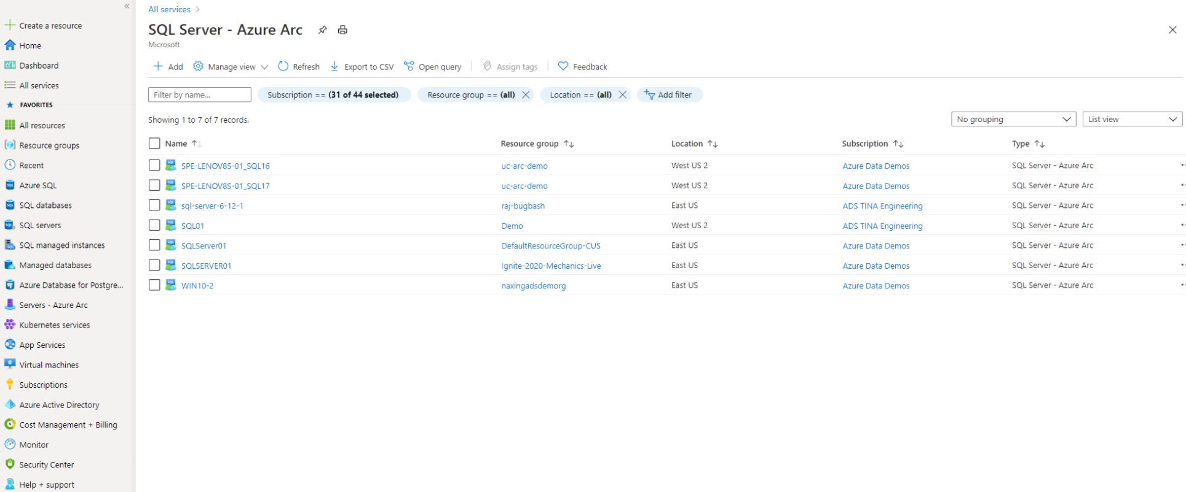

Slide 29
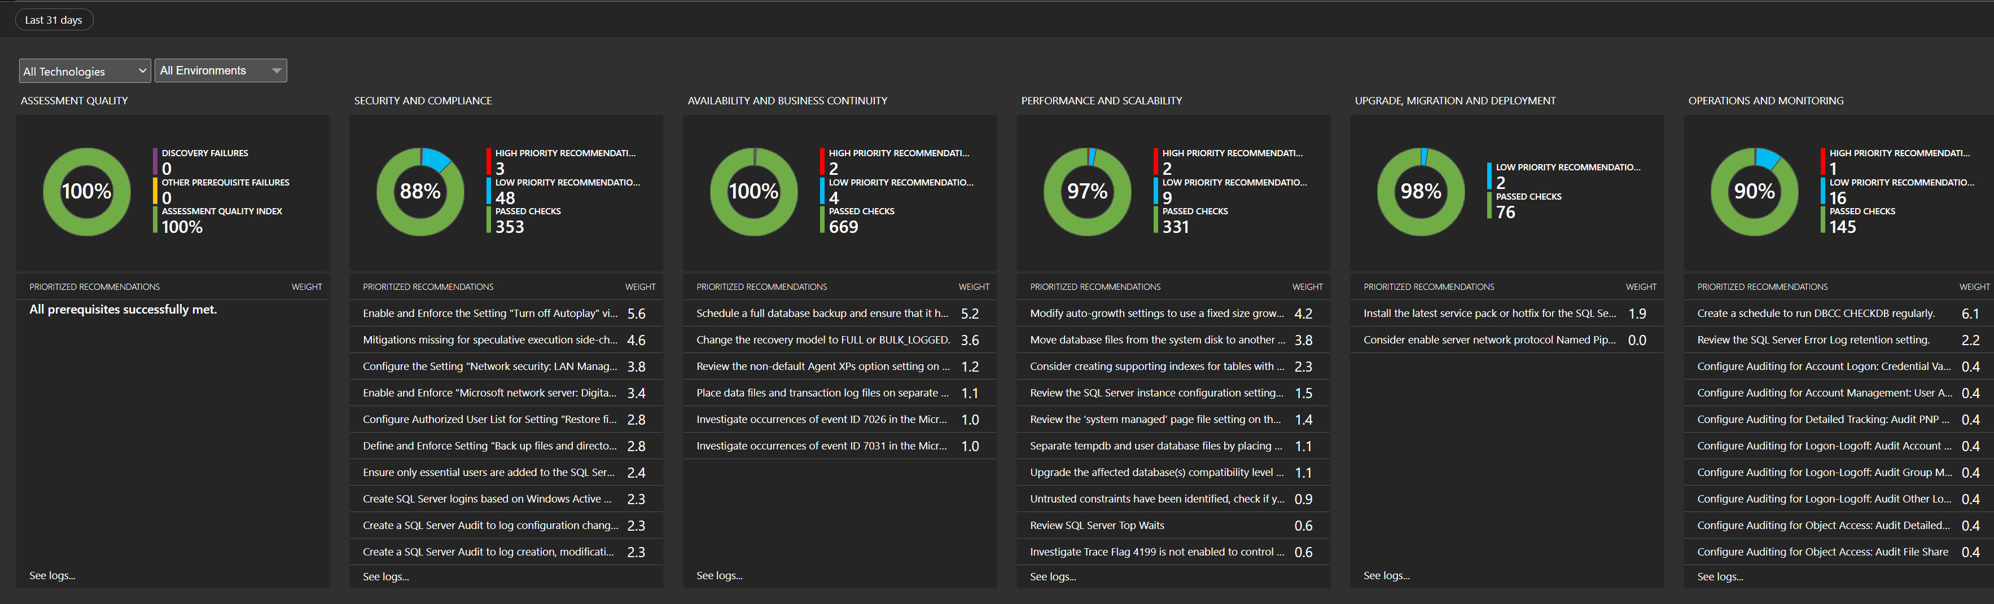
SQL Server Assessment

Slide 30

Customer scenario At-scale Kubernetes app management
Overview
A retailer with 100s of stores would like to move all in-store applications to containers running on a K8s clusters
They are faced with the challenge of how to uniformly deploy, configure and manage their containerized applications across multiple locations
Business requirements
Bootstrap a new store to fully run with the applications and configuration that this store requires
Enable IT to apply and monitor at scale governance across all stores
Monitor the state of applications and configuration in all stores
Integrate DevOps and Safe Deployment Practices for applications running in stores
Notes:
So now let’s talk about at-scale Kubernetes app management, another core use case enabled by Azure Arc.
We are working with a retailer who have 100s of stores and have in-store applications. They’d like to move all these applications to containers running on Kubernetes clusters but they are not sure how they can uniformly deploy and configure these applications across multiple locations. They need to be able to onboard a new store that can run with the specific applications that this store needs, apply governance, monitor these clusters as well as integrate DevOps practices. Many customers need this today.

Slide 31
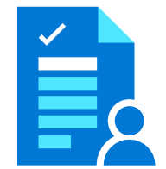

Customer scenario At-scale Kubernetes app management
Customer scenario At-scale Kubernetes app management
Azure Management
(Azure Resource Manager, Azure Policy, Azure Portal, API, CLI…)
Key benefits from Azure Arc
Asset organization and inventory with a unified view in the Azure Portal across all locations
GitOps-based model for deploying configuration as code to one or many clusters
Application deployment and update at scale
Source control based Safe Deployment Procedures when rolling new applications and configurations
Developer tooling agnostic—use the tools they want
Notes:
This is where Azure Arc enabled Kubernetes comes into play. You can project the Kubernetes clusters to Azure, so you can organize and view all your clusters in Azure (similar to Azure Arc enabled servers) but you can also configure them uniformly, called zero touch configuration. This practice is called GitOps, which is a Kubernetes operating model. In GitOps, the configurations are declared and stored in a Git repo and our Arc agents running on the cluster continuously monitor this repo for updates or changes and automatically pulls down these changes to the cluster. This in turn enables safe deployment practices as the agents ensure that the cluster conforms to the ‘desired state’ as declared by the organization. Any deviation from this desired state will result in an automated rollback.

Slide 32
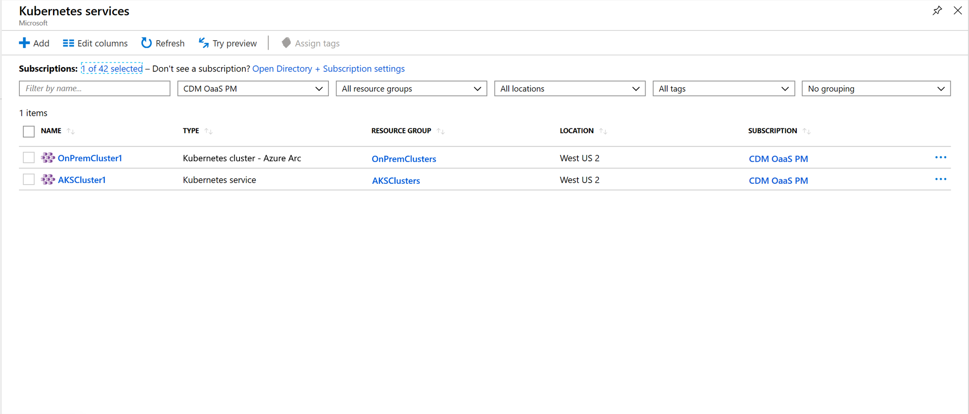
Notes:
If you look at this in the Azure Portal, for customers used to manage Kubernetes clusters in Azure, they have a consistent experience. Here, you can see the Arc enabled Kubernetes cluster alongside an AKS cluster running in Azure. You can deploy configurations to both these clusters.

Slide 33
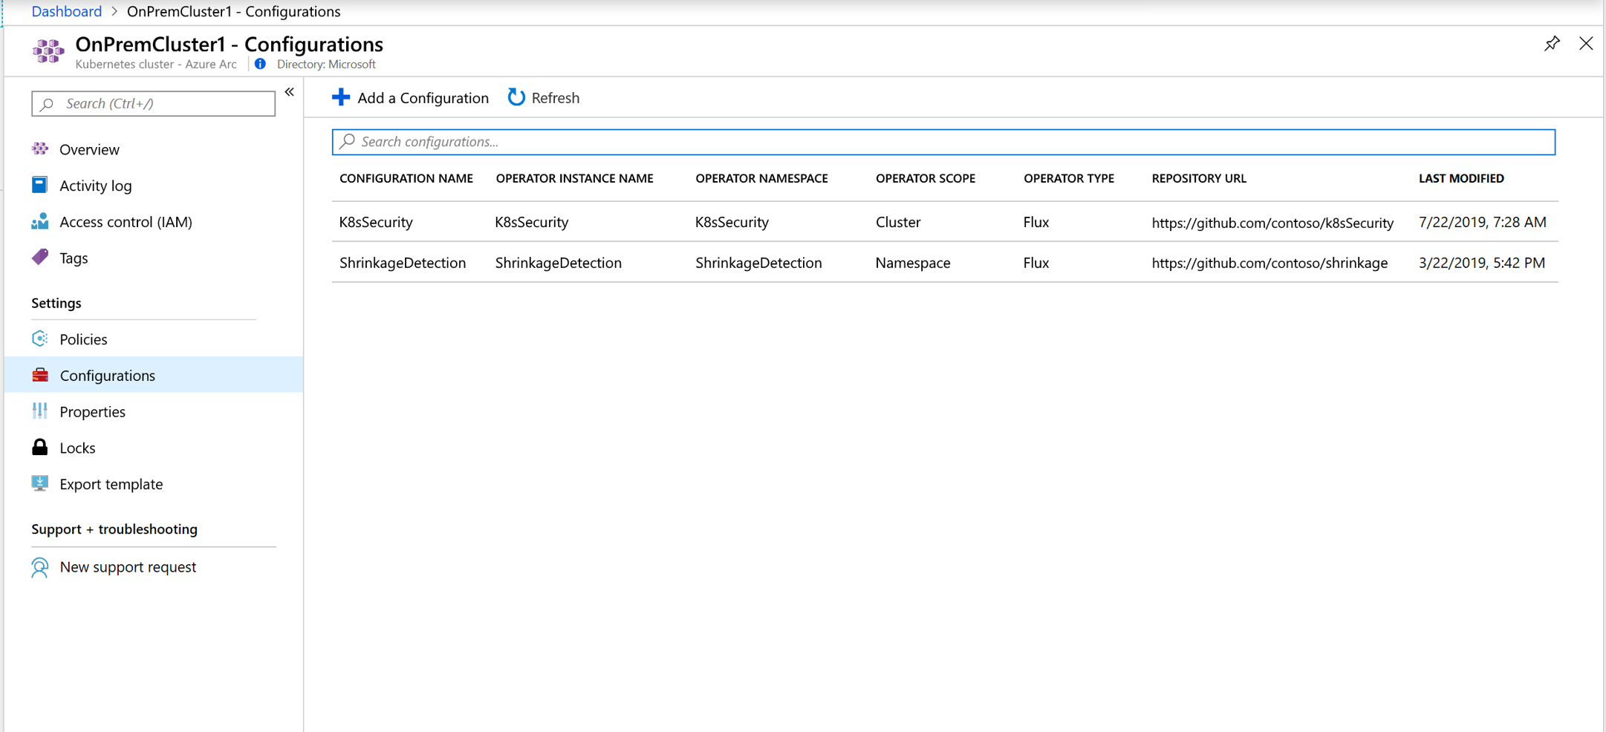
Notes:
In this screen, you can see the configurations being applied. You can apply these configurations with Azure Policy so you can apply these at scale. Say for example, I need the K8sSecurity configuration to be applied to all clusters in my resource group. I also need the ShrinkageDetection application to be applied to all my clusters tagged as store clusters, so whenever there is a change in the application, the cluster automatically gets updated. You can see that the GitHub URLs for the configurations are different, so you can actually have multiple applications run by different departments. You can also have different IT configurations to ensure the cluster is compliant. So in the retail customer scenario, the Kubernetes clusters in the new store, once connected to Azure Arc will automatically get all the configurations without the IT admin having to do anything. This is indeed a powerful scenario.

Slide 34




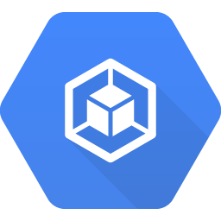

Azure Arc enabled Kubernetes Connect, manage, and operate Kubernetes clusters and applications running anywhere using Azure Arc
Now in Preview
Govern and Secure
Connect
Configure
Operate and Monitor
Support for multiple flavors
Deploy to an existing cluster
OSS ecosystem friendly
Configure GitOps workflows
Enforce desired state across clusters
Cluster & Namespace support
Azure Monitor Integration
Health status reporting
Cluster & App observability
Built-in Azure Policies
Cluster security baseline
Role-Based Access Control
Compliance across environments
Any infrastructure, any Kubernetes
kubeadm
AKS
OpenShift
EKS
GKE
VMware Tanzu
Notes:
So, just want to summarize Azure Arc enabled Kubernetes for you.
Again, similar to Arc enabled servers, we offer a lot of flexibility to you based on your specific needs. We support a wide range of Kubernetes distributions with flavors from different vendors – as you can see on the slide. You can connect all these clusters to Azure and start deploying applications to these clusters using a GitOps-based model.
Additionally, you can enable cluster health monitoring with Azure Monitor for Containers. Another powerful capability is the integration with Azure Policy that can ensure compliance with the organization’s security baselines.

Slide 35
Customer scenario Run Azure data services anywhere
Overview
An Energy company aims for an efficient and fully automated operation with AI everywhere
Customer operates various production sites, as well as run utility transporting from extraction to retail distribution
Massive data volume at the edge and need real-time insights
Business requirements
Leverage existing OEM hardware and any Kubernetes
Automation at scale for IT control systems e.g., HA/DR, backup, CI/CD, DevOps
Latest innovation automatically deployed from edge to cloud
Consistent security and governance
Private Cloud - Enterprise business systems challenges
Lots of manual effort for CI/CD, especially for data tier
Variety of DB engines, with versions facing EOS, security siloes; no elastic scale
Mix of containers and VMs on OEM hardware
Azure data services
Customer-managed services on any infrastructure
Data aggregation
Model updates
Edge - real-time processing challenges
Custom code needed for streaming, data sync and AI
Sensors
Legacy, basic database with no AI built
Actuators
OEM edge servers/workstations

Slide 36
Customer scenario Run Azure data services anywhere
Key benefits from Azure Arc
Any infrastructure, any K8s
Always on the latest, no end-of-support with evergreen SQL in Azure SQL DB
Elastic scale on-premises with PostgreSQL Hyperscale
Azure SQL Database Edge with built-in AI for real-time edge analytics
Automation at scale with unified management of all data & AI assets
Market leading security & governance consistently deployed everywhere
Private Cloud - Enterprise business systems challenges
Lots of manual effort for CI/CD, especially for data tier
Variety of DB engines, with versions facing EOS, security siloes; no elastic scale
Mix of containers and VMs on OEM hardware
K8s management
Azure Policy
Azure Role-based control
Azure Security Center
Azure Arc enabled data services
Data aggregation
Model updates
Edge - real-time processing challenges
Custom code needed for streaming, data sync and AI
Sensors
Legacy, basic database with no AI built
Actuators
OEM edge servers/workstations

Slide 37

Azure Arc enabled data services
Bring Azure data services to on-premises, multi-cloud, and edge with Azure Arc
PREVIEW
Azure SQL Managed Instance
Azure Database for PostgreSQL Hyperscale
Disconnected support
Cloud benefits for both disconnected and connected workloads
Always current
Elastic scale
Unified management
Automated updates
Evergreen SQL
Hyperscale on-premises
Deploy in seconds
Scale up, scale out
Automation at scale
Single view for on-prem and clouds
Consistent workflows
Any hardware, any Kubernetes
Notes:
With Azure Arc, you can now bring Azure data services to any infrastructure across on-premises data centers, edge and 3rd party clouds, using Kubernetes on hardware of your choice. For customers who need to maintain data estate on-premises, you will gain unique benefits for those on-premises data workloads.
First, you will always be current, meaning updates and upgrades are fully automated, and the deployment is controlled by your policy. You will gain unique and cloud proven innovation ahead of any other hybrid cloud offering like the evergreen SQL with no end-of-support through Azure SQL Database, and the hyperscale deployment option of Azure Database for PostgreSQL.
Second, we will bring cloud elasticity on-premises so you can optimize performance of data workloads with the ability to dynamically scale up/down and scale out, without application downtime.
Moreover, by connecting to Azure you will gain unified management. Imagine being able to see your data services running on-premises along side those running in Azure through a single pane of glass, using familiar tools like Azure Portal, Azure Data Studio and Azure CLI.
For the first time, you will be able to access Azure’s industry leading security and governance capabilities to your on-premises data workloads using Azure Security Center, Azure policy and Azure RBAC to protect your data on-premises.
Best of all, you can now have the option to use modern cloud billing model for better cost efficiency across your hybrid infrastructure.

Slide 38





Azure Arc enabled data services Architecture
Data/Azure Admin
Azure Arc Integration
Azure Portal
Azure Data Studio
Identity
Azure RBAC & Policy
Advanced Data Security
Deployments & Config
Resource Inventory
Logs & Telemetry
Backup Retention
Consumption
Azure CLI
Azure Arc Extension
azdata CLI
Azure Arc Data Controller
PostgreSQL Hyperscale
Azure SQL Managed Instance
Future
data services
Future
Analytics Engines
API
Azure Arc Integration
Monitoring & logs
Patching & Updates
Backup
Scaling
fluentbit
collectd
fluentbit
collectd
HA/DR
Provisioning
Any Kubernetes Cluster
Kubernetes
API
AKS
AKS on Azure Stack HCI
OpenShift
EKS
GKE
VMware Tanzu
kubeadm
Any Infrastructure
Notes:
Let’s explore what your experience would look like when you deploy Azure Arc enabled data services to your infrastructure. So you start at the bottom layer, and this could be any infrastructure that you currently have in your environment – VMware, Hyper-V, Azure Stack Hub or could be EC2 instances on AWS.
On this infrastructure, they’d then deploy a Kubernetes distribution of their choice. This could be a commercial distribution like RedHat’s OpenShift or a managed K8s layer such as AKS in Azure or on Azure Stack HCI or EKS/GKE on the other clouds.
Now, up in Azure, we have the Azure Portal and Azure CLI and Azure Data Studio can talk to the Azure CLI or API. We also have the Microsoft Container Registry which has all the container images required for this deployment.
So given this, how does a customer deploy Azure Arc enabled data services?
First step is for the customer to deploy the control plane, they can do it through the Azure Data Studio or azdata CLI to the Kubernetes API to pull down the container images to stand up the Azure Arc Data Controller. The data controller is a set of container images that are provisioned on Kubernetes and provide all the management services mentioned on the slide such as Monitoring, Backup, HA/DR etc. The data controller has an integration with Azure Arc that allows it to exchange information back and forth with Azure. Some data will flow up such as resource inventory of the instances that are deployed in your local data centers that re projected into ARM. We want the local monitoring and logs to be sent up to Azure Monitor. Also billing telemetry will be sent up to Azure. Some information fill flow down, this includes the policies, RBAC and security assessments.
Once the data controller is in place, the different instances can be provisioned such as SQL Managed Instance and PostgreSQL Hyperscale.
Images Required for Arc Data Services
1. arc-bootstrapper
2. arc-postgres-11
3. arc-postgres-12
4. arc-control-watchdog
5. arc-controller
6. arc-sqlmi
7. arc-monitor-collectd
8. arc-monitor-elasticsearch
9. arc-monitor-fluentbit
10. arc-monitor-grafana
11. arc-monitor-influxdb
12. arc-monitor-kibana
13. arc-monitor-telegraf
14. arc-server-controller
15. arc-service-proxy

Slide 39
Which SQL Database deployment do I need?
Where will the SQL DB
be deployed?
Outside of Azure
Microsoft
Who do I want to manage
the SQL instance?
I will
What do I need?
Full instance
More control
Just a single SQL DB
Shared pool of resources
for multiple SQL DBs
Azure Arc enabled SQL Managed Instance
Managed Instance
Single Database
Elastic Pools
Any Kubernetes Cluster
Azure infrastructure
Any infrastructure

Slide 40

Which PostgreSQL Database deployment do I need?
Where will the PostgreSQL DB
be deployed?
Outside of Azure
Microsoft
Who do I want to manage
the PostgreSQL instance?
I will
What do I need?
Just a single server
Superior scale for multi-tenant apps &
real-time analytics apps
Azure Arc enabled PostgreSQL Hyperscale
Azure Database for PostgreSQL
Azure Database for PostgreSQL Hyperscale (Citus)
Any Kubernetes Cluster
Azure infrastructure
Any infrastructure

Slide 41
Management capabilities comparison by deployment model
Built-in Capabilities | Deployment Model
 | Customer Infrastructure |  | Azure
 | SQL Server / PostgreSQL | Azure Arc enabled databases | Azure PaaS databases
Database security features
Elastic / “Limitless” scalability |  | Limited by the capacity of customer infrastructure
Automatic HA/DR |  | Customer responsible for underlying HW/K8s availability
Auto upgrade, patching
Auto backup-restore
Monitoring
Compliance certifications | Customer responsible for compliance certification | Customer responsible for compliance certification | 90+ certifications
Data sovereignty |  |  | Azure regions not available in all countries yet
Customer control |  |  | Pre-defined HW options No control over HW/OS
Fully managed by Microsoft | Customer-managed | Customer-managed using software provided by Microsoft
Guaranteed availability SLA | Customer-managed | Customer-managed using software provided by Microsoft

Slide 42

Azure is already trusted and proven by our customers. Azure Arc uses the same APIs and the same control plane as Azure, providing consistency across the hybrid infrastructure, which increases productivity and reduces risk.”
Mike DeLuca
Global Lead for Hybrid
Avanade
Notes:
Avanade, a Microsoft Platinum partner, is using Microsoft Azure Arc to unify its customers’ hybrid infrastructures.
Situation : IT infrastructures often span on-premises, cloud, hybrid, and edge computing. This complicates IT management, app development, and governance. Systems integrator Avanade wanted to help simplify workload migration decisions and infrastructure management for its customers
Solution : Avanade, a Microsoft Partner, uses Microsoft Azure Arc to extend Azure management and services across all types of infrastructure. The data Azure Arc surfaces includes not just technical and descriptive details, but also compliance and governance policies.
Impact : With Azure Arc, Avanade helps customers make more-informed decisions about cloud migration, and they can now manage their entire infrastructure through a universal control plane. With Azure Lighthouse, Avanade can better manage customer resources and continue building strong customer relationships
Read more here : https://customers.microsoft.com/en-us/story/836305-avanade-partner-professional-services-azure-arc

Slide 43

For me, the main benefit is that my managers do not have to go to three different places to see the health of our database environment. I want to reinforce this over and over again because that’s what’s driving us.”
Kristina Melo
SQL Database Administrator
Ferguson
Notes:
Ferguson is the largest wholesale and retail provider of plumbing and waterworks supplies in the United States, with more than 27,000 employees and annual revenues of $15 billion. As a leader in its industry, Ferguson’s IT department is constantly looking for new technologies to drive the business and better serve its associates, customers, vendors, and contractors.
Situation : Ferguson, the largest wholesale distributor of residential and commercial plumbing supplies in the United States, wanted to understand how it could connect its disparate IT landscape and centralize the management of that landscape.
Solution : With Azure Arc enabled servers, Ferguson can project its on-premises servers into Azure and organize them using tags like they would any other Azure resource. Ferguson is using this feature to plan out future migration projects. Azure Arc also enables Ferguson to apply the same governance policies used to audit its Azure virtual machines to its on-premises machines. Azure Arc also enables Ferguson to apply the same governance policies used to audit its Azure virtual machines to its on-premises machines. Additionally, they are using Azure Arc enabled SQL Managed Instance to run versionless SQL in their on prem environments, a big need. This helps their senior DBAs save time.
Impact : By binding their Azure and on-premises environments together through policies and tagging, they can create a consistent way to deploy and manage our systems in a disparate environment. That’s important to them as they become leaner as an organization, they still need to effectively manage their IT footprint. Migrating data was a smooth and fast process, and managers didn’t have to go to multiple locations to see the health of the database environment. Ferguson also anticipates that SQL version control and other features will help reduce senior administrators’ time spent upgrading different versions of databases.
https://customers.microsoft.com/en-us/story/844232-ferguson-enterprises-retailers-azure-arc

Slide 44
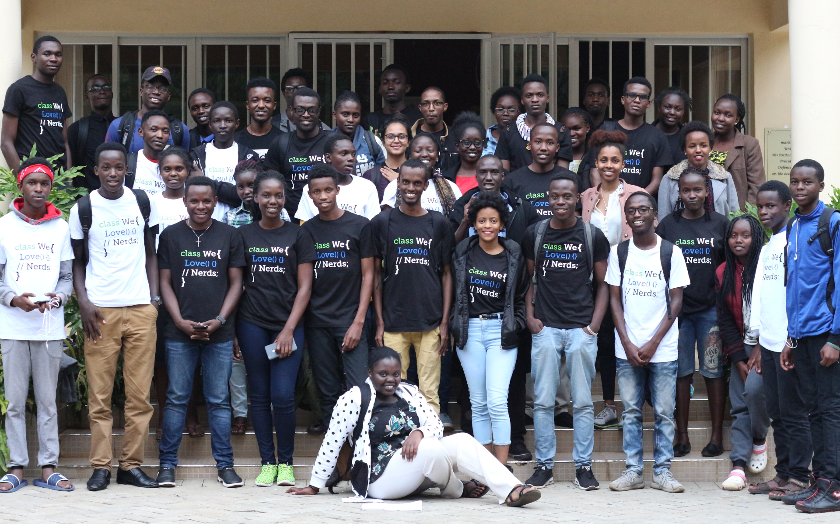
With Azure Arc, we can centrally manage multiple edge locations and help our customers grow and expand across the continent, creating more jobs and economic opportunities along the way.”
Calvin Karundu
Software engineer
Africa’s Talking
Notes:
With locations spread across Africa, Kenya-based company Africa’s Talking provides custom mobile, voice, messaging, and payment APIs for large organizations and thousands of developers.
Situation : Africa’s Talking wanted to give its 50,000 developers and more than 6,000 enterprise customers a way to organize, govern, and manage Kubernetes clusters and servers across multiple environments and to deploy data services anywhere from a single point.
Solution : Using Microsoft Azure Arc, the company can now manage Kubernetes clusters across multiple environments regardless of its customers’ locations. And, its customers can deploy location-sensitive applications and services.
Impact : Africa’s Talking has empowered its customers with tools they feel comfortable using, enabling more efficient and less expensive development. And with datacenter access no longer an issue, Africa’s economies and its people will benefit.
Read more here : https://customers.microsoft.com/en-us/story/842233-africas-talking-partner-professional-services-azure-arc

Slide 45

Azure Arc is the key enabling technology for us to deliver software as a service to the edge within our customers' local on-premises networks.”
Thomas Gossler
Chief Architect for Teamplay
Siemens
Notes:
Siemens Healthineers delivers digital services to cloud-connected customers through the teamplay digital health platform, a software platform it developed and manages in Microsoft Azure. Siemens Healthineers provides medical equipment, software, and IT consulting to hospitals to help them deliver better patient care. The main business of the company is selling and servicing diagnostic equipment such as MRI scanners, CT scanners, X-ray machines, and ultrasound machines to hospitals in 70 countries across the globe. The machines are loaded with Siemens Healthineers software applications, which optimize performance and provide specialized services.
Situation : Siemens Healthineers has a software application called teamplay Receiver, which runs inside customers’ networks and is co-located to on-site diagnostic equipment, such as MRI and CT scanners. teamplay Receiver connects to the cloud service that Siemens Healthineers developed, teamplay digital health platform, which runs on Microsoft Azure. For a variety of reasons, Siemens Healthineers’ customers must keep and process much of their scanning machine data on-premises. Data privacy rules vary among countries and among health care providers, with some preventing patient information from leaving hospital grounds under any circumstances. Even when it’s not required, some hospitals choose to process their data in an on-premises infrastructure because of privacy concerns. In other cases, hospitals lack the bandwidth to send large image files back and forth. Because of this critical constraint, Siemens Healthineers needed a way to connect to edge machines without sending patient data to the cloud. It developed a partial solution allowing remote connections to machines, but it had many limitations.
Solution : With Azure Arc, Siemens Healthineers can deploy and manage applications on Kubernetes clusters across tens of thousands of locations. It can also monitor, update, and help secure all applications from Azure, where its teamplay cloud runs. “Azure Arc is the key technology we use to deliver software as a service to the edge within our customers’ local on-premises networks,” says Thomas Gossler, Chief Architect for teamplay at Siemens Healthineers.
Azure Arc also allows Siemens Healthineers to view and manage all infrastructure, policies, and assets—whether they’re running in on-premises datacenters, at machines on the edge, or in the cloud—from a single control plane in Azure.
Impact : Azure Arc is a game changer for Siemens Healthineers. It gives their customers choices and enables the continuous delivery of Kubernetes workloads from the cloud to the edge, at scale and as a service.
Read more here : https://customers.microsoft.com/en-us/story/842233-africas-talking-partner-professional-services-azure-arc

Slide 46


“Ford welcomed the opportunity to participate in the private preview of Azure Arc enabled data services. We are always looking at new and different tools to improve delivery speed of database services to our customers with on-premise metered consumption and self-service.”
Ford Motor Company

Slide 47


With Azure Arc we are able to distribute solutions and workloads across multiple clouds and data centers to support our clients that would have otherwise been bound to a data center.”
Aram Lauxtermann
Director, Cloud
KPMG

Slide 48

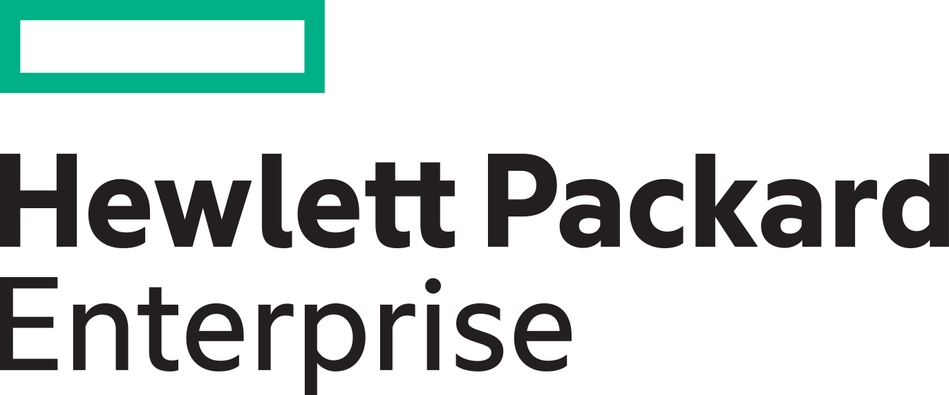

We are excited to see Microsoft bringing Azure data services and management to any infrastructure. Through our partnership with Microsoft we hope to deliver a true “as-a-service” experience across environments to help manage both the databases and the underlying infrastructure and offer a consistent experience across on premises and the cloud.”
Erik Vogel
VP, Customer Success
Hybrid Cloud Software and Services Hewlett Packard Enterprise
Notes:
Customers are already excited about Azure Arc.
Erik Vogul, the VP of customer success at Hewlett Packard Enterprise said:
“We are excited to see Microsoft bringing Azure data services and management to any infrastructure. Through our partnership with Microsoft we hope to deliver a true “as-a-service” experience across environments to help manage both the databases and the underlying infrastructure, and offer a consistent experience across on premises and the cloud.”

Slide 49
Azure Arc enabled servers pricing
No additional cost
Control plane functionality:
Tagging, management groups, activity logs, templates, Resource Graph, RBAC
Customers servers and clusters
Notes:
Let’s take a look at the pricing model for Arc enabled servers. So first, you have your own servers and clusters, you install the Arc agent on them. This basic connectivity to Azure is free of charge. In addition, we offer other control plane functionality at no additional cost – tagging, the ability to organize resources into management groups and subscriptions, RBAC and querying with Azure Resource Graph.
<One click>

Slide 50
Azure Arc enabled servers pricing
Additional services
Azure Policy—guest configuration
Azure Monitor
Azure Security Center
Azure Defender—standard
Azure Sentinel
Backup
Log Analytics
Service Map
Application Insights
Network Watcher
Azure Sentinel
Config and Change Management
No additional cost
Control plane functionality:
Tagging, management groups, activity logs, templates, Resource Graph, RBAC
Customers servers and clusters
Notes:
So what gets charged then?
Any Azure management service, that you can see listed here, when attached to the server will be charged. The pricing model for these services will be the same as they are today for Azure VMs. For example, Azure Monitor for Arc enabled VMs will be priced the same way as it would be for Azure VMs.
The only exceptions are Azure Policy Guest Configuration and Azure Automation services such as Update Management, DSC, Change tracking and inventory, which are free for Azure VMs but charged at $6/server/month for Azure Arc enabled VMs. You could just use one of these or all of them together, the price remains at $6/server/month.

Slide 51
Addressable Revenue Opportunity Large TAM; millions of on-premises servers, double digit growth in containers
Expand management to
on-premises servers
Grow your business
with containers
Serve expanding
edge workloads
~12m on-premises physical servers growing to ~15 million by 2024¹
Use of containers growing
from 70% to ~90%³
~50% of the data will be
created on edge by 2023⁴
~50-70m virtual machines
growing to 80-90m by 2024²
Double digit growth
Large enterprises
shift to containers
Healthcare pandemic accelerating edge devices adoption;
expand your business with it
IDC Enterprise Infra Tracker; 2. Assumption: 1 physical servers = ~4 virtual machines, 3. CNCF, production and development 4. Gartner; Top 10 trends Dec ‘19

Slide 52


Example: Azure Arc Partner Opportunity – Migration + Sentinel
Scenario: A customer has 100 VMs (Linux/Windows) running on-premises. The VMs consist of file servers, SQL instances, web servers and backend servers. You as a partner have been brought in to conduct an analysis of the infrastructure, execute the migration and implement Azure Sentinel as a SIEM solution using a unified operations strategy.
Azure Policy
$6/Azure Arc enabled server/month per Guest Config Policy
+ Sentinel ACR $
50 x Azure Arc enabled Servers
Migration
50 x Azure VMs + Sentinel
50 x On-Premises VMs
50 x Azure VMs
50 x Azure Arc enabled Servers + Sentinel
100 x On-Premises VMs
ACR $ generated
from the migration
+
Sentinel ACR $
Notes:
We are starting with 100 on-premises virtual machines, generating 0$ ACR
By migrating 50 of these VMs to Azure, we are generating ACR only for these 50 VMs but “leaving money on the table” for the other 50 on-premises VMs who “stayed behind”
We are now enabling Azure Sentinel for the 50 Azure VMs which generates more Azure ACR but we are still not generating ANY ACR for the “stayed behind” on-premises VMs
Now, by onboarding the 50 on-premises VMs into Azure Arc, which does not have a cost, we are making progress towards generating ACR for the on-premises VMs
By applying Azure Policy, which will enforce Azure Sentinel on all 50 on-premises Azure Arc enabled servers, we are now generating 6$ per Azure Arc enabled server via Azure policy as well as ACR $ coming from Azure Sentinel This means we are maximizing the ACR opportunity and no longer leaving money on the table!
This example shows the potential of “unlocking” an Azure service such as Sentinel for on-premises assets which without Azure Arc, would have not generate any ACR,
Like Azure Sentinel, other Azure services can be unlocked using Azure Arc. Services such as (but not limited to) Azure Security Center, Azure Monitor, Azure Log Analytics, etc. can now all be applied and utilized by Azure Arc enabled servers.

Slide 53




Example: Azure Arc Partner Opportunity – Migration + Sentinel
Scenario: A customer has 100 VMs (Linux/Windows) running on-premises. The VMs consist of file servers, SQL instances, web servers and backend servers. You as a partner have been brought in to conduct an analysis of the infrastructure, execute the migration and implement Azure Sentinel as a SIEM solution using a unified operations strategy.
Azure Policy
$6/Azure Arc enabled server/month per Guest Config Policy
+ Sentinel ACR $
50 x Azure Arc enabled Servers + Azure Services
Migration
50 x Azure VMs + Sentinel
ACR $ generated
From the migration
+
Sentinel ACR $
Notes:
This example shows the potential of “unlocking” an Azure service such as Sentinel for on-premises assets which without Azure Arc, would have not generate any ACR,
Like Azure Sentinel, other Azure services can be unlocked using Azure Arc. Services such as (but not limited to) Azure Security Center, Azure Monitor, Azure Log Analytics, etc. can now all be applied and utilized by Azure Arc enabled servers.

Slide 54
Azure Arc Partner Opportunity
Use case
Azure services enabled by Azure Arc
Outcomes
Organize and govern across environments
Azure Policy, Azure Monitor, Log Analytics, Security Center, Azure Sentinel,
Azure Update Management
Adoption services (x% revenue, y% margin)
Managed services (x% revenue, y% margin)
Accelerators (x% revenue, y% margin)
At-scale Kubernetes app management
Azure K8s Config Management,
Azure Policy for Kubernetes,
Azure Monitor for Containers
Adoption services (x% revenue, y% margin)
Managed services (x% revenue, y% margin)
Accelerators (x% revenue, y% margin)
Run data services anywhere
Azure SQL Managed Instance,
Azure PostgreSQL Hyperscale
Adoption services (x% revenue, y% margin)
Managed services (x% revenue, y% margin)
Accelerators (x% revenue, y% margin)
Notes:
We’ve just seen an example of the value Azure Arc brings to you in a migration scenario even when some workloads cannot move to Azure in the short term (or even long term in some cases). What does this mean for you in terms of your revenue opportunity?Tying back to the Arc use cases we talked about at the very beginning, each scenario delivers a unique value proposition and brings specific Azure services to customer environments.
Organize and govern : This is all about extending the Azure control plane and the Azure management services to existing VMs and physical servers anywhere.
At-scale K8s app management : This is the cloud native scenario where Azure Arc enables you to deploy and manage Kubernetes applications with GitOps.
And finally Azure Arc enabled data services enables deployment of native Azure data services anywhere.
In all of these scenarios, you have different levers to realize economic benefits. You have services associated with the actual deployment of Azure Arc, managed services associated with managing the customer environments and ongoing support as well as ACR incentives and accelerators that Microsoft provides you with. There is enormous opportunity and potential here for you!

Slide 55
Contoso MSP delivering value with Azure Arc
Complex IT management services extended on-premises
Comprehensive VM management experiences extended on-premises
Base VM management experiences extended on-premises
Azure Policy, Azure Update Management
Azure Policy, Azure Security Center, Azure Sentinel, Azure Monitor, Azure Update Management
VM management, At-scale Kubernetes app management, data services anywhere
Notes:
Do we see all these 3 scenarios happening together? Highly unlikely. Most customers will undertake a phased approach but you can add value at each stage as depicted here.
Here’s an example with a fictitious MSP, Contoso.
You can start with the customer’s existing infrastructure. For those VMs that cannot be migrated to the cloud, onboard them to Azure Arc and the different Azure management services. Most customers start with basic services such as Azure Policy and Update Management which can bring immediate value to their on-premises servers.
You can think of the next phase as a more comprehensive VM management experience taking advantage of a broader set of Azure Management services such as Monitor and Azure Sentinel depending on the use case and customer requirements (at-scale monitoring of all servers from a single pane of glass, cloud native SIEM solution for entire landscape) etc.
The last phase brings the full power of Azure Arc, where you help the customer with server management, Kubernetes app deployments as well data services to meet their regulatory or latency needs.

Slide 56
Pricing for Arc enabled Kubernetes and data services
Both Azure Arc enabled Kubernetes and Azure Arc enabled data services are in preview. We will announce pricing details closer to GA.
Notes:
So what gets charged then?
Any Azure management service, that you can see listed here, when attached to the server will be charged. The pricing model for these services will be the same as they are today for Azure VMs. For example, Azure Monitor for Arc enabled VMs will be priced the same way as it would be for Azure VMs.
The only exceptions are Azure Policy Guest Configuration and Azure Automation services such as Update Management, DSC, Change tracking and inventory, which are free for Azure VMs but charged at $6/server/month for Azure Arc enabled VMs. You could just use one of these or all of them together, the price remains at $6/server/month.

Slide 57
Azure Arc roadmap
Today
H1 CY21
General availability
Azure Arc enabled servers
Public preview
Azure Arc enabled SQL Server
Azure Arc enabled Kubernetes
Azure Arc enabled data services
Azure SQL Managed Instance
Azure PostgreSQL Hyperscale
General availability
Azure Arc enabled SQL Server
Azure Arc enabled Kubernetes
Azure Arc enabled data services
Azure SQL Managed Instance
Azure PostgreSQL Hyperscale

Slide 58
What do we hear from customers?
“I need to manage security and incident management across my public cloud and datacenter assets through policy enforcement and automation.”
“As a Managed Service Provider, I need to operate and govern my customer’s Azure ,on-premises and other clouds environments.”
“I want my on-premises servers to have strong integration with Azure and tools like Security Center and Sentinel.”
“As a DevOps Engineer, I would like for all my applications in our existing and future production Kubernetes clusters, to be deployed with same versioning and with no configuration drift.”
“As an SRE (Site Reliability Engineer), I need to have health visibility in single pane of glass fashion to all my existing and future Kubernetes clusters, infrastructure and applications.”
“We use SQL Server to integrate with our mission critical application platform, but the DB layer must remain on-premises due to sensitive patient data and data availability needs.”

Slide 59







Azure Customer
Management Services
Monitoring | Update | Containers | Backup | Security Center | More…
Access and Security
RBAC | MSPs | Subscriptions
Organization and Inventory
Search | Index | Groups | Tags
Tools and Experiences
Azure
Resource
Manager
(ARM)
Portal
PowerShell
CLI
API
Environments and Automation
Templates | Extensions
Governance and Compliance
Logs | Policy | Blueprints
SDK
Ecosystem
Marketplace
Azure Resources
Azure Arc
Multi-Cloud
On–Premises / Hosted Services
Azure Data Studio
Customer Environments
Existing
Tools
Kubernetes Tools
Server Admin Tools
Notes:
Just to unpack this a bit more on How Azure Arc works.
Customers connect to Azure using different tools or experiences such as the Azure Portal. What’s happening behind the scenes is that those tools and experiences are interacting with the Azure Control plane which is essentially Azure Resource Manager or ARM. Every single resource in Azure is connected to this control plane. Azure Resource Manager at its core, provides a core set of capabilities – inventory, organization and governance for Azure resources, which you can see on the slide (Servers/K8s/data services). As an example, when you want to a create a new resource in Azure, that request is received by the Azure Resource Manager, which then authenticates and authorizes the request. Resource Manager sends the request to the specific Azure service, which takes the requested action. So you essentially have a consistent tool for working with all your Azure resources. Once these resources are created, you can attach additional Azure Management services such as Azure Monitor, Azure Security Center to these resources. <Click>
So what we did with Azure Arc is to extend this single control plane within Azure and those same capabilities , that we just talked about, to resources outside of Azure. This involves deploying an agent on the servers or Kubernetes clusters so these resources can be projected to the Azure Resource Manager. Once the initial connectivity is done, you can now see all these resources in the Azure Portal. You can group these resources, apply tags and RBAC policies as well as attach Azure management services such Azure Monitor, Azure Security Center etc., the same way as you would for Azure resources. So for IT admins, Azure Arc really brings that consistency and single pane of glass experiences to thousands of servers in customer environments.
A key point to add here is that you can continue to use your existing tools on-premises to interact with these resources, we are not interfering with any of those management tools.

Slide 60
Azure Arc Architecture
Customer locations (on-premises/clouds)
Resource specific tools
Management Interfaces
Azure Resource Manager (ARM)
Azure data services
Azure Data Studio
Azure Arc Data Resource Provider (RP)
Azure Arc Data Agent
Azure Portal
Identity
Azure CLI
Kubernetes Cluster
K8s Native Tools
Azure SDK
RBAC
Container Registry
Azure Arc Data Controller
Cluster provisioning​
Cluster upgrade and patch management​
Cluster lifecycle management​
Cluster monitoring
Policy
Azure Arc K8s
Resource Provider (RP)
Index
GitOps Manager
Azure PaaS Control
Azure Arc K8s Agent
Groups
Azure Arc Server Resource Provider (RP)
Servers
Etc.
Linux
Server Admin Tools
Azure Arc Server Agent
Windows Server
Azure Arc Components
Notes:
This is the architecture for Azure Arc all-up.
On the left side, we have the Azure Resource Manager in Azure as well as the resource providers for Azure Arc. On the right side, we have the Arc agents deployed on your infrastructure in your location, which sent heartbeat signals up into Azure.
We also enable you to continue to use the management tools you are familiar with, whether that’s Server admin tools, K8s cluster management tools, DevOps tools or Azure Data Studio for managing the data assets.

Slide 61
GitOps – Definition & Principles
Git as the source of truth for a system
Git as the single place where we operate
(create, change, and delete)
All changes are observable
System state described declaratively
State declaration versioned in source control
Approved changes are applied automatically
Agents enforce desired state
https://www.weave.works/technologies/gitops/
Notes:
Azure Arc enabled Kubernetes adopts a GitOps methodology, so customers define their applications and cluster configuration in source control. This means changes to apps and configuration are versioned, enforced, and logged across any number of clusters.
Let’s explore some of the principles of GitOps :
Single source of truth – Git
All actions taken by developers/admins – create, change and delete happens in Git
All changes are visible to project teams and can be tracked
Declarative Configuration: All resources managed through a GitOps process must be expressed declaratively.
Version controlled, immutable storage: The declarative descriptions are stored in a repository that supports immutability, versioning and version history. For example, git.
Automated delivery: Delivery of the declarative descriptions, from the repository to runtime environment, is fully automated.
Software Agents: Reconcilers deploy and maintain the resources described in the declarative configuration. Actions are performed on divergence between the version controlled declarative configuration and the actual state of the target system.

Slide 62





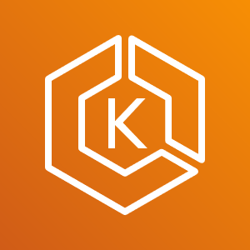
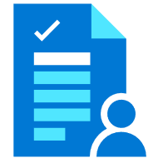
Azure Arc enabled Kubernetes GitOps Flow
Arc Connected
Kubernetes Cluster
GitOps
Configurations
Flux Operator +
Helm Operator
4
git
Repository
1
2
3
Google Kubernetes
Engine (GKE)
Flux
pickup changes
Application
Rolling Update
Azure Kubernetes Service on HCI
8
7
Application
Deployment
git merge
5
6
Elastic Kubernetes Service (EKS)
Application V2
(New Desired State)
Application V1
(Desired State)
Application
Changes
Rancher K3s
Any Kubernetes,
any Infrastructure
Notes:
So what does the GitOps flow look like in the context of Arc enabled Kubernetes?
We are starting with Kubernetes clusters outside of Azure
Azure Arc Kubernetes connected cluster is created
User creates cluster’s GitOps configurations
Flux operator gets deployed on the cluster, and starts ”listening” to the git repository with the user’s application code
Flux operator initiates user’s application deployment on the cluster, representing the current desired state
User is updating the application (creating a new app version) and merge changes to the repository
Flux pickup a change to the git repository
Flux operator initiates a new user’s application version deployment on the cluster while removing old version application pods, resulting in a new Desired State

Slide 63

The Azure Arc Jumpstart GitHub Repository
Provide a “zero to hero” scenarios for multiple environments and deployment type using as much automation as possible
Create a ”supermarket” experience by being able to take “off the shelf” scenarios and implement it
Meeting Azure Arc customers where they are
https://aka.ms/AzureArcJumpstart
Notes:
Repository design principles:
Provide a “zero to hero” scenarios for multiple environments and deployment type using as much automation as possible
Create a ”Supermarket” experience by being able to take “off the shelf” scenarios and implement (eat) them.
Meeting Azure Arc customers where they are

Slide 64
Get started
Azure Arc enabled servers is now generally available, get started today: https://aka.ms/Azure-Arc
Try Azure Arc enabled Kubernetes, in preview: https://aka.ms/Azure-Arc-Kubernetes
Try Azure Arc enabled data services, in preview: https://aka.ms/hybrid-data-services
Learn more
Azure Arc
Any Infrastructure, Any Cloud
Azure Arc Jumpstart: https://aka.ms/AzureArcJumpstart
Technical documentation: https://aka.ms/AzureArcDocs
Azure Arc Learning Path: https://aka.ms/AzureArcLearn

Slide 65








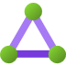

Azure Arc enabled servers Connectivity Options
Direct connection (Internet)
Connection via Proxy (Internet)
Service tag (S2S VPN/ER)
Private Link (S2S VPN/ER) - Private Preview
Azure Arc Service Endpoint
Public Endpoint
Private Endpoint
Internet
Azure Arc enabled Server
Service tag
Private Link
Proxy
Azure Express Route &
Site-to-Site VPN
Azure VNET

Slide 66

Azure Arc enabled servers architecture Linux OS
Azure AD
Azure Automation
Azure Monitoring
Azure Security Center
Azure Sentinel
System Administrator
Azure Resource Manager
(ARM)
Hybrid Identity Service
Hybrid Compute Resource Provider
Guest Configuration Resource Provider
Log Analytics Workspace
HTTPS/443
On-premises/other clouds
Azure Arc Connected Machine Agent
Hybrid Instance Metadata Service
Guest Configuration
Extension Manager
/var/opt/azcmagent/
/var/lib/GuestConfig
Log Analytics Agent
Custom Script
/var/opt/azcmagent/tokens
DSC
Microsoft Dependency Agent
/opt/GC_Ext/downloads
/var/lib/waagent/<extension>

Slide 67
Azure Arc enabled servers architecture Windows OS
Azure AD
Azure Automation
Azure Monitoring
Azure Security Center
Azure Sentinel
System Administrator
Azure Resource Manager
(ARM)
Hybrid Identity Service
Hybrid Compute Resource Provider
Guest Configuration Resource Provider
Log Analytics Workspace
HTTPS/443
On-premises/other clouds
Azure Arc Connected Machine Agent
Hybrid Instance Metadata Service
Guest Configuration
Extension Manager
%ProgramFiles%\AzureConnectedMachineAgent
%SystemDrive%\Program Files\ArcConnectedMachineAgent\ExtensionService\GC
Log Analytics Agent
Custom Script
%ProgramData%\AzureConnectedMachineAgent
%ProgramData%\GuestConfig
DSC
%ProgramData%\AzureConnectedMachineAgent\Tokens
Microsoft Dependency Agent
%ProgramData%\AzureConnectedMachineAgent\Config
%SystemDrive%\AzureConnectedMachineAgent\ExtensionService\downloads
%SystemDrive%\Packages\Plugins\<extension>>

Slide 68

Azure Arc enabled servers Connected Machine Agent
Azure Admin
Azure Arc Connected Server (On-Premises, AWS EC2, etc.)
Azure Arc Connected Machine Agent
Azure Portal
Az CLI
Azure SDK
REST API
Azure AD
Parameters passed to the Agent:
Subscription ID
Location
Resource Group
Proxy (optional)
Azure Service Principal
Authentication & Authorization
Azure Resource Manager (ARM)
Hybrid Instance Metadata Service (HIMDS)
Handles managed identity and communication with Azure AD
HTTPS/443
Hybrid Compute
Resource Provider
Guest Configuration
Provides In-Guest Policy and Guest Configuration functionality, such as assessing whether the machine complies with required policies
HTTPS/443
Guest Config
Resource Provider
Extension Manager
Manages VM extensions, including install, uninstall, and upgrade
Update Management
Log Analytics
(MMAExtension)
HTTPS/443
Log Analytics Workspace

Slide 69




Azure Arc enabled servers Azure Key Vault Integration
System / Security Administrator
1b
Public Key Infrastructure (PKI)
AKV is configured with Azure Managed Identity for allowing the Azure Arc enabled server to access certificates
Azure AD
6
Upon renewal time, the certificates are renewed only in AKV
(renewed PKI certs can be uploaded as well)
Azure Key Vault (AKV)
3b
AKV Extension background service
retrieve AKV certificates based on interval specified in the extension configuration
1a
User Certificates
Admin deploy Azure Key Vault
The AKV agent will then sync down the new certificate and private key automatically at its next sync interval
3a
AKV Extension background service request for
a Managed Identity token in order to retrieve certificates
Azure Arc enabled server
2a
2b
AKV extension is deployed on the
Azure Arc enabled server
Hybrid Compute
Resource Provider
Certificates URIs are used as parameters and syncs based on user-defined time intervals
App/Service
(i.e. Web Server)
Extension Service
AKV Extension Background Service
App/Service consumes local cert store certificate
(as well rebind upon renewal)
5
4
The certificates and private keys are stored in the local certificate store (Windows) or as files in a directory (Linux)
Cert Store

Slide 70

Azure Arc enabled Kubernetes Onboarding
K8s Cluster Admin
Azure Container Registry
Azure AD
3f
1
3e
Create Service Principal in AAD
5b
az connectedk8s connect
Create Managed Identity
Managed Identity Service
Fetch the identity certificate
Hybrid Identity Service
Fetch Helm chart
2
Azure CLI
Azure Resource Manager
(ARM)
4
Send identity metadata
3d
6d
PUT resource Microsoft.Kubernetes/connectedClusters with public key (management.azure.com)
Microsoft.Kubernetes
Resource Provider (RP)
Update cluster metadata
Azure Arc enabled Kubernetes Data Plane Service
PUT connectedCluster resource
along with Managed Identity metadata
3g
6c
Pull agent images
Push cluster metadata
(uses Managed Identity to authenticate eastus.dp.kubernetesconfiguration.com)
3c
On-Premises/Cloud Provider Kubernetes Cluster
6a
API Server
Fetch cluster metadata and update custom resource
Cluster Metadata Operator
3a
Uses Helm to deploy Arc enabled
k8s agents with onboarding
private key
3b
6b
Save state/
Onboarding private key
in k8s datastore
Watch for updates in cluster
metadata custom resource
Resource Sync Operator
etcd
5a
Save the Azure Identity Certificate
5c
Cluster Identity Operator
Fetch connectedCluster Managed Identity certificate
(uses onboarding private key to authenticate eus.his.azure.com)

Slide 71
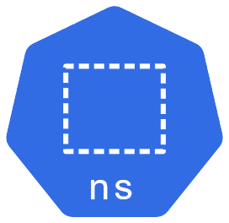
Azure Arc enabled Kubernetes GitOps Configuration
K8s Cluster Admin
3
4
PUT sourceControlConfiguration resource
Store sourceControlConfiguration resource
1
Azure Resource Manager
(ARM)
Microsoft.KubernetesConfiguration
Resource Provider (RP)
Azure Arc enabled Kubernetes Dataplane Service
az k8sconfiguration create
Azure CLI
5
13
GET Pending sourceControlConfiguration resources
(uses Managed Identity to authenticate)
POST status for the Flux agents
to be retrieved with resource GET
2
PUT resource
Microsoft.Kubernetes/connectedClusters/clusterName/providers/Microsoft.KubernetesConfiguration/sourceControlConfigurations/configName
(uses ARM Extension Resource pattern)
On-Premises/Cloud Provider Kubernetes Cluster
Git Repository
6
Create gitconfigs CR
Config Agent
YAML Files
Helm Releases CRs
Namespace
12
obj-x
Collect Status from Flux
7
helmreleases CR
release-a
gitconfigs CR
config-a
Watch gitconfig CRs
controller-manager
9
obj-y
Helm Release
Flux watches Git repo, creates k8s resources
based on raw YAML
and helmreleases CRs
8
Create or update
Flux Operator or
Flux-Helm Operator
obj-z
10
Flux-Helm Operator
Flux Operator
Flux-logs
agent
Flux-Helm Operator watches helmreleases CRs,
pulls Helm chart and creates Helm release
Flux events sent to upstream service
11

Slide 72

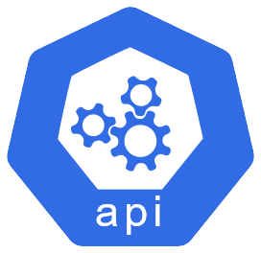



Azure Arc enabled Kubernetes AAD enabled RBAC
Owner
Role assignment in Azure
checkAccess
allowed/denied
Azure Arc enabled Kubernetes Cluster
TokenAccessReview,
SubjectAccessReview
Azure AD Entity
(User Account/Service Principal)
kubectl get pods
API Server
Guard
If allowed, return list of pods
allowed/denied

Slide 73

Azure Arc enabled Kubernetes Cluster Connect
Customer Location
(On-Premises/Cloud Provider)
Azure AD Entity
(User Account/Service Principal)
listClusterUserCredentials
Azure Resource Manager (ARM)
Microsoft.Kubernetes
Resource Provider (RP)
Kubernetes Cluster
kubectl get pods
Cluster Connect Endpoint
Hybrid Connections
Customer
Firewall
clusterconnect-agent
API Server
Dataplane Service
heartbeat

Slide 74



Azure Arc enabled Kubernetes Azure Monitor
Azure Monitor for containers
Workbooks
Log Analytics
Alerts
Send metrics and logs
Azure Arc enabled Kubernetes Cluster
node-1
node-2
node-n
oms-agent
oms-agent
oms-agent
Collect metrics
and logs
Collect metrics
and logs
Collect metrics
and logs
pod-a
pod-b
pod-a
pod-b
pod-a
pod-b
pod-c
pod-d
pod-c
pod-d
pod-c
pod-d
create

Slide 75

Azure Arc enabled Kubernetes Azure Policy (Gatekeeper)
Azure Policy Service
Azure Arc enabled Kubernetes Cluster
Pod
Service
CRD
PolicyTemplate CRD
Deployment
Ingress
Config
PolicyInstance CRD
Fetch policy definitions & assignments
&
Report compliance
watch
create
AdmissionReview request
Gatekeeper
Calling entity
kubectl apply –f privileged.yaml
API Server
deploy
azure-policy-addon
AdmissionReview response allowed: false
OPA
Denied
create

Slide 76
Azure Arc enabled Kubernetes Cluster extension (Private Preview)
6
GET version
Azure Container Registry or
Microsoft Container Registry
K8s Cluster Admin
3
4
PUT extension resource
Store extension resource
1
Azure Resource Manager
(ARM)
Microsoft.KubernetesConfiguration
Resource Provider (RP)
Azure Arc enabled Kubernetes Data Plane Service
az k8s-extension create
Azure CLI
5
GET Pending extension resources
(uses Managed Identity to authenticate)
12
9
2
Fetch Helm chart
stored as OCI artifact
PUT resource
Microsoft.Kubernetes/connectedClusters/clusterName/providers/Microsoft.KubernetesConfiguration/extensions/extensionName
(uses ARM Extension Resource pattern)
POST extension status
On-Premises/Cloud Provider Kubernetes Cluster
7
Create extensionconfig CR
Config Agent
Namespace
11
obj-x
Collect Status
8
extensionconfigs CR
extension
Watch extensionconfig CRs
extension-manager
obj-y
Helm Release
Install helm chart
10
obj-z
Notes:
Currently Azure Arc enabled Kubernetes supports add-on scenarios like Azure Monitor and Azure Policy (Gatekeeper) via manual installation of Helm charts. With private preview of Cluster extensions, the lifecycle of the add-ons are managed by cluster administrators.
The new Cluster Extensions feature provides management experience (via CLI, Azure portal and API) to deploy and configure integrated services like Azure Monitor. Users can now install and remove, configure auto upgrades, choose release trains, and securely pass in configuration settings without risking secret exposure – all using Azure APIs. More new extensions for Azure Policy (Gatekeeper), Azure Defender, Open Service Mesh are coming soon.

Slide 77


Azure Arc enabled Data Services Endpoints
azdata CLI
Kubernetes tools
azdata CLI
Browser
Azure Data Studio
PostgreSQL tools & drivers
Azure Data Studio
SQL tools & drivers
HTTPS
HTTPS
HTTPS
TCP
TCP
Any Kubernetes Cluster
Azure Arc Data Control Plane
Azure Arc Data Control Plane
Azure Arc enabled data services
Kubernetes API
Azure Arc Data Controller
Metrics & Logs UI
Azure PostgreSQL Hyperscale
Azure SQL Managed Instance

Slide 78


Contoso MSP Tenant Powered by Azure Lighthouse
Access Management
Portal & Dashboarding
Policy & Governance
Monitoring
Logging & Analytics
Cost Management
Security
Patch Management
BC/DR
MSP 3rd Party
Solutions Integration
Service Health
& Support
Fabrikam Azure Tenant
Parnell Aerospace Azure Tenant
App Services
Fourth Coffee Azure Tenant
Virtual Machines
Storage
Network
Kubernetes
Service
Data
Services
Cosmos DB
Functions
Parnell Aerospace
On-Premises Datacenter
Parnell Aerospace
Multi-Cloud Workloads
Azure Arc enabled infrastructure & services
Fourth Coffee
On-Premises Datacenter
Fourth Coffee
Multi-Cloud Workloads
Azure Arc
Azure Arc
SQL Server
Azure Arc
SQL Managed
Instance
Azure Arc
PostgreSQL
Hyperscale
Azure Arc
SQL Server
Azure Arc
SQL Managed
Instance
Azure Arc
PostgreSQL
Hyperscale
Bare-Metal
Servers
Windows & Linux
Servers
Kubernetes
Bare-Metal / VM
AWS
EC2
Elastic
Kubernetes
Service (EKS)
GCP
Instance
Google
Kubernetes
Engine (GKE)
Azure Arc Data Controller
Azure Arc Data Controller
Fabrikam On-Premises Datacenter
Fabrikam Multi-Cloud Workloads
Notes:
To wrap it all-up, I think this one slide summarizes everything we’ve talked about. This also show the integration with Azure Lighthouse in a multi-tenant, multi-cloud management scenario.

Slide 79
Fabrikam Azure Tenant
Virtual Machines
Storage
Network
App Services
Kubernetes
Service
Data
Services
Cosmos DB
Functions
Azure Arc enabled infrastructure & services
Azure Arc
Azure Arc
SQL Server
Azure Arc
SQL Managed
Instance
Azure Arc
PostgreSQL
Hyperscale
Azure Arc
SQL Server
Azure Arc
SQL Managed
Instance
Azure Arc
PostgreSQL
Hyperscale
Bare-Metal
Servers
Windows & Linux
Servers
Kubernetes
Bare-Metal / VM
AWS
EC2
Elastic
Kubernetes
Service (EKS)
GCP
Instance
Google
Kubernetes
Engine (GKE)
Azure Arc Data Controller
Azure Arc Data Controller
Fabrikam On-Premises Datacenter
Fabrikam Multi-Cloud Workloads
Notes:
To wrap it all-up, I think this one slide summarizes everything we’ve talked about. This also show the integration with Azure Lighthouse in a multi-tenant, multi-cloud management scenario.

Slide 80
Resources
Azure Arc all up overview
Azure Arc enabled Kubernetes & servers
Azure Arc enabled data services
aka.ms/arc-introvideo
Introducing Azure Arc
aka.ms/azurearcpricing Azure Arc pricing page
aka.ms/arc-techcommunity
Deep dives on Azure Arc, best practices and more
aka.ms/arc-customerstories
Learn how other customers are implementing Azure Arc
https://aka.ms/arc-feedback
Public Q&A forum
AzureArcContact@microsoft.com Ask to be added to a common Teams site and monthly call with engineering
aka.ms/arc-blog Azure Arc: Extending Azure management to any infrastructure
aka.ms/arc-k8svideo
Kubernetes—Managing K8 clusters outside of Azure with Azure Arc
aka.ms/arc-serversvideo
Server management—Organize all your servers outside of Azure with Azure Arc
aka.ms/arc-serversdocs
Documentation for Azure Arc enabled servers
aka.ms/arc-k8sdocs
Documentation for Azure Arc enabled Kubernetes
aka.ms/AzureArcJumpstart
Azure Arc "Jumpstart" GitHub repository
aka.ms/arc-datablog
Blog – Run Azure data services on-premises, at the edge, and multi-cloud with Azure Arc
aka.ms/arc-data-mechanicsvideo
Demos on Azure Arc enabled data services, including SQL and PostgreSQL Hyperscale
aka.ms/arc-data-ignitevideo
Ignite 2020 session—Bring Azure data services to on-premises, multi-cloud and edge
aka.ms/arc-datadocs
Documentation for Azure Arc enabled data services

Slide 81
Thank you

Slide 82
Inconsistent governance practice across cloud and on-premises environments
Varied customer onboarding processes
What are we hearing from partners?
Incomplete regulatory and compliance views
Capex and opex for managing different sets of tools supporting complex IT environments
“…managing customer’s environments at multiple locations is complex…”
Expanding business opportunities—edge, low latency
Several others…

Slide 83






























Azure Arc can help simplify and standardize to capture the opportunities
Extend Azure management across your environments
Implement Azure security anywhere
Adopt cloud practices on-premises
Run Azure Data Services anywhere
Azure Arc is a set of technologies that extends Azure management and enables Azure services to run across on-premises, multi-cloud, and edge

Slide 84
Azure Lighthouse
Your Practices
Multi-cloud
Datacenter
Edge
Azure Lighthouse
Azure Management
Azure Arc
Customer 1
Customer 1
Customer 2
Customer 2
Customer 3
Customer 3
Notes:
So far we learnt about Azure Lighthouse and Azure Arc. Let’s see how this can work for a service providers/partners.
As a service provider, with Lighthouse you have a precise, granular access to customers Azure environment. A customer can delegate a specific subscription or resource group to Service provider, who can manage multiples customers from their own environment.
We hired 3rd party company - Forrester to quantify the impact of Lighthouse on partners. Per Forrester, Azure Lighthouse can help a medium size partner save ~$2-3M/year in opex.
In addition, our own analysis tells us that the Azure environment that is managed by a partner through Lighthouse, grows in revenue incrementally by ~10-20% faster than normal growth.
Click.

Slide 85
Azure Lighthouse and Azure Arc Azure Arc extends Azure management, services, and Azure Lighthouse anywhere
Your Practices
Multi-cloud
Datacenter
Edge
Azure Lighthouse
Azure Management
Azure Arc
Customer 1
Customer 1
Customer 2
Customer 2
Customer 3
Customer 3
Windows Server | Linux | Kubernetes | SQL | Azure data services
Notes:
Now, through Arc, similar capabilities and benefits can also be applied to customers' environments that are everywhere. These hybrid management capabilities can provide partners generate even additional operational savings and growth opportunities.

Slide 86
Azure Lighthouse and Azure Arc New opportunities for partners
Expand your revenue opportunities
Improve operational efficiency
Overcome common customer objections
Manage servers anywhere
Manage Kubernetes anywhere
Build hybrid cloud native apps
Resell and use Azure services
Standardize DC operations
Consistent tooling
Simplify and automate governance
Enforce security
Ensure compliance
Address latency
Develop visibility
Provide control
Azure | AWS | GCP | Kubernetes | Windows | Linux | Data

Slide 87


Azure Lighthouse and Azure Arc What it means for partners
Expand your revenue opportunities
Improve operational efficiency
Overcome common customer objections
“Azure Arc was the missing link that now enables us to offer a unified and comprehensive managed cloud service regardless of where the workloads are located—supporting us to cover a wider range of customer use cases.”
“With Azure Arc, automation that supports a single environment can be leveraged to support an entire footprint; Actions can be uniformly maintained and applied across an entire fleet.”
“With Arc, we can meet customers wherever they are and offer them proximity and flexibility with their workloads, while helping them set of a digital modernization path.”
Stephan Baumann Deutsche Telekom AG Lead Partner Manager Microsoft and T-Systems
Scott Harvey
CTO Atmosera
Mike DeLuca
Global Lead, Hybrid and Edge
Avanade
Notes:
Several partners are investing heavily and developing unique product offerings based on Arc and Lighthouse. T-systems is seeing an opportunity to expand their business into wider infra management opportunities, Atmosera is leveraging to improve the operational efficiency and Avanade is meeting some of the most frequently asks of their customers.

Slide 88








Azure Arc launch partners
CloudAssured@smartronix.com
AskAzure@fujitsu.com
solutions@dexmach.com
AzureArc.Info@avanade.com
Arcformsp@t-systems.com
arc@cleardata.com
AzureArc@acuutech.com
connect@atmosera.com
Alliances@insight.com
CISCloudOfferingUp@cognizant.com
sales@snp.com
contact@us.brainscale.com

Slide 89
Appendix

Slide 90
Azure Arc enabled servers pricing Example 1
Scenario 1: A customer onboards 50 Windows (or Linux) servers that are running on-premises to Azure with Azure Arc and tags these servers in Azure, applies RBAC, organizes these servers into management groups and queries properties with Azure Resource Graph. In addition, the customer also applies a set of common Azure Policy Guest Configurations across all these servers.
The applicable cost components are:
Component | Cost
Connectivity to Azure Arc, Tagging, RBAC, Management Groups and Azure Resource Graph | $0
Azure Policy Guest Configurations | $6/server/month (Unlimited policies)
For more details on Azure Arc pricing visit our pricing page: https://aka.ms/azurearcpricing

Slide 91
Azure Arc enabled servers pricing Example 2
Scenario 2: A customer onboards 50 Windows (or Linux) servers that are running on-premises to Azure with Azure Arc and tags these servers in Azure, applies RBAC, organizes these servers into management groups and queries properties with Azure Resource Graph. The customer also applies a set of common Azure Policy Guest Configurations across all these servers. In addition, the customer deploys the Log Analytics agent extension to monitor the on-premises servers (Azure Monitor).
The applicable cost components are:
Component | Cost
Connectivity to Azure Arc, Tagging, RBAC, Management Groups and Azure Resource Graph | $0
Azure Policy Guest Configurations | $6/server/month (Unlimited policies)
Azure Monitor | Same Azure Monitor pricing that is applicable to Azure VMs (Refer to the Azure Monitor Pricing page to learn more)
For more details on Azure Arc pricing visit our pricing page: https://aka.ms/azurearcpricing

Slide 92
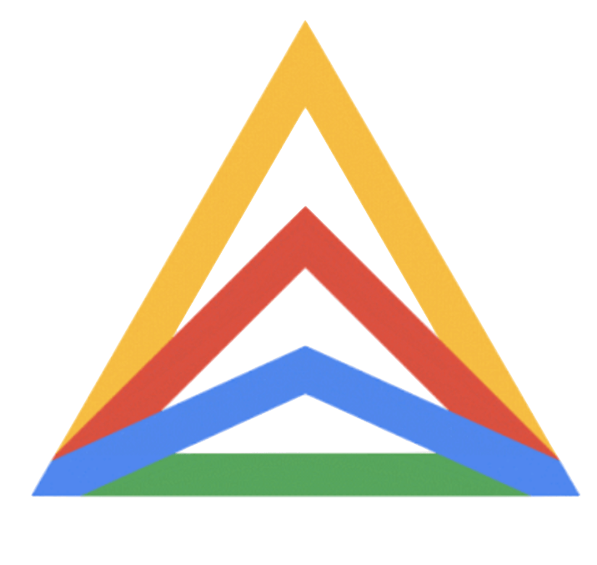

Google Anthos comparison
Azure Arc
Google Anthos
Estate coverage
VMs, servers, and any Kubernetes
Kubernetes only, limited support for VMs
Infrastructure
Any virtualization
Any Kubernetes distribution
VMware based virtualization
GKE ; AKS, EKS (only supports version 1.16)
Cloud benefits
Evergreen SQL without EOS
PostgreSQL Hyperscale
BigQuery Omni, Hybrid AI
No support for evergreen SQL or any other managed database services
Connectivity
Continuous/intermittent
Disconnected/totally air-gapped
Continuous/intermittent only
Internal only

